Slide 1
Building Leadership Skills for Young Professionals
Coalition for the Delaware River Watershed Forum
October 2019
Sarah Clark

Slide 2
Use Yourself
Photo by Mohamed Nohassi on Unsplash

Slide 3
Get a Fresh Look
Photo by Julia Kuzenkov on Unsplash

Slide 4
Session
Have practical ways to:
Set Goals
Network
Make Decisions/Solve Problems

Slide 5
Set Goals

Slide 6
“Begin with the end in mind. If you aim for nothing, you’ll hit it every time.” – Unknown
“ The greater danger for most of us isn’t that our aim is too high and we miss it, but that we aim too low and reach it.” - Michelangelo
“When I dare to be powerful, to use my strength in the service of my vision, then it becomes less and less important whether I am afraid” – Audre Lorde
WHY?

Slide 7
Setting Goals
Start with the end in mind:
5 year/10 year vision
1 year goal
Break into smaller tasks:
6 months – 1 month – 1 week
Daily To Do

Slide 8
SMARTIE
Specific
Measurable
Ambitious
Realistic
Time Bound
Inclusive
Equitable
The Management Center

Slide 9
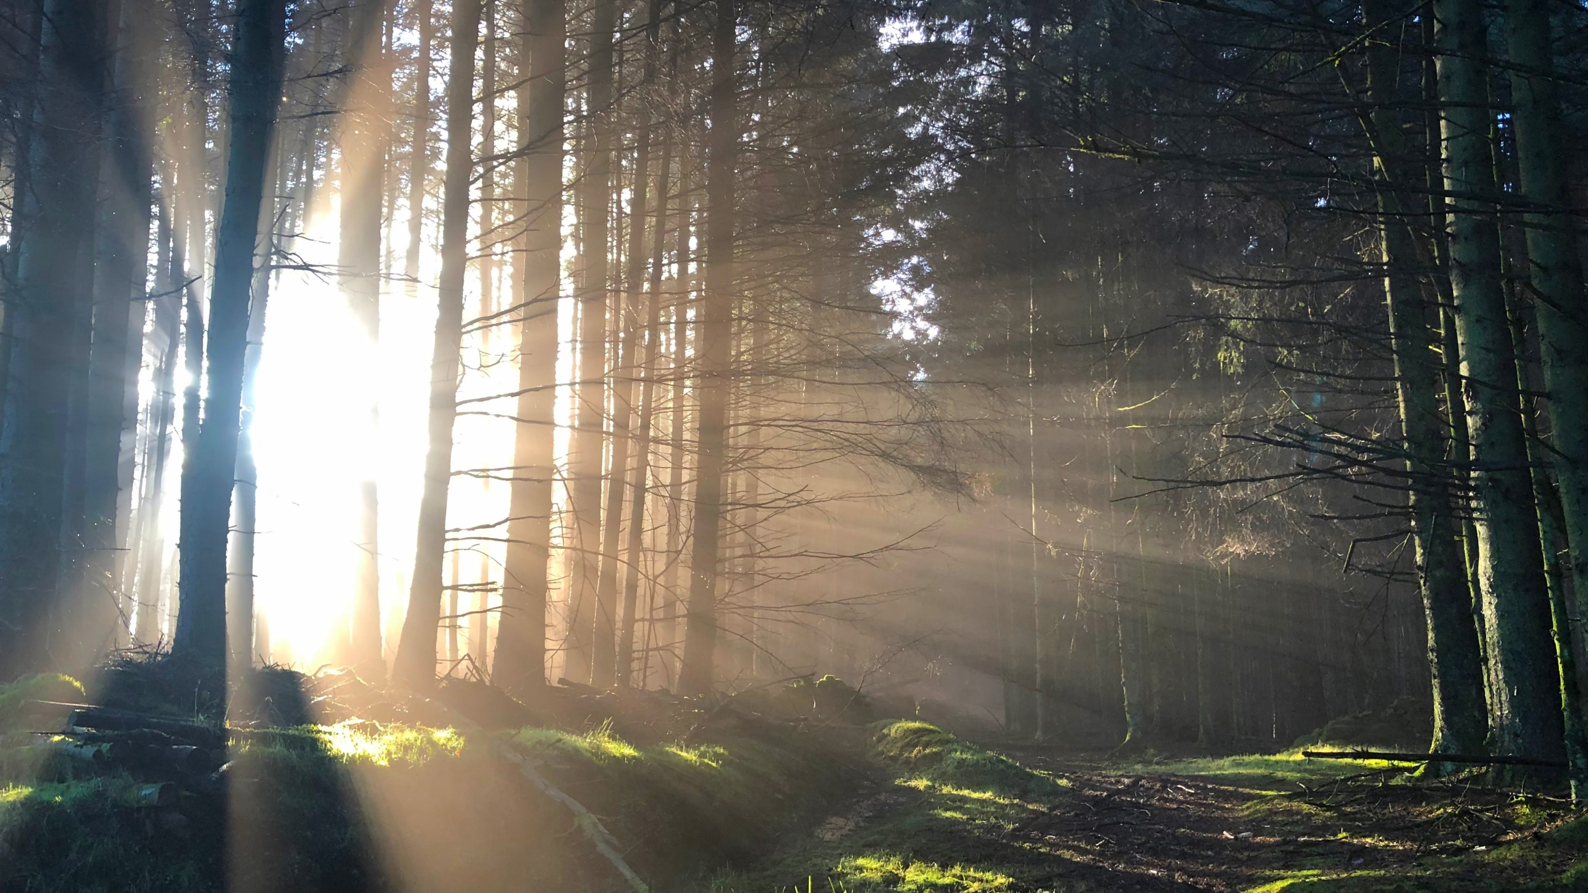
Set a professional development goal
In the next 12 months. . .
Photo by Marty Finney on Unsplash

Slide 10
Networking

Slide 11
Anyone!
Job Search
Learning
Resource Sharing
Be:
Intentional
Systematic
Photo by Sarah Pflug from Burst

Slide 12
Speed Networking
Introduce yourself
How would you describe what you do in one sentence?
What do you want to learn more about?
Networking goal? (I want to meet someone who. . . .)
Photo by Wynand van Poortvliet on Unsplash

Slide 13
Decision Making/ Problem Solving

Slide 14
Managing Up
Do what told
Propose upon request
Act and inform
Develop plan w/guidance
Initiate proposal

Slide 15
Decision Making Spectrum - for Leaders
JOINT | CONSULT | TEST | PERSUADE | TELL
What do you think we should do? Which path is your preference? | What ideas do you have? If you were in my shoes, what would you do | Do you agree with the proposal? What would it take for you to agree this is the right path? | What would it take to make you enthusiastic about this? What do you think it will take to make this work well? | Do you have any questions about how we are moving forward? Do you need anything from me to get going on this?
From The Management Center

Slide 16
Problem Solving (Logical)
1. Define problem, challenge, opportunity
2. Generate solutions
3. Explore costs/benefits; pros/cons
4. Select an option
5. Implement
6. Assess/modify

Slide 17
What must we stop doing to make progress on our deepest purpose? (TRIZ)
Determine worst possible result
List what can cause that result
Are you doing any of those bad things?
Decide first steps for stopping bad acts
How will you know that your changes are successful?
Source: Liberating Structures

Slide 18
Write Down
What is one thing you are going to do in the next two weeks as a result of this workshop?

