Slide 1
SUSTAINING YOURSELF TO SUSTAIN YOUR LEADERSHIP
Aisha Moore, MPH | October 17, 2019 | NJ Audubon Society

Slide 2
1. Objectives
Introductions
Identify unhealthy habits and patterns that sabotage the ability to serve effectively
Explain the importance of a leadership mission
Build your own self-care plan

Slide 3
What brought you to this workshop today?

Slide 4
Self-care By Aisha

Slide 5
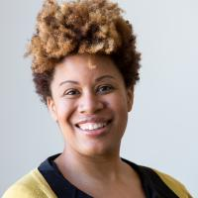
Day In The Life of Aisha
Deputy director level position at a public health consulting firm for a few years.
She was board president of one organization and sat on the board of three others. Married dog mom.
Notes:
Describe a typical day as I did in the SOAS emails. (5 mins).

Slide 6
5 Mistakes I Made That Turned Leadership Dream Into A Nightmare
#1 Being Focused on A Title
#2 Failure To Self Assess
#3 Letting Impostor Syndrome Get The Best of Me

Slide 7
5 Mistakes I Made That Turned My Leadership Dream Into A Nightmare
#4 Putting Others Needs Before My Own
#5 Not recognizing the signs of stress

Slide 8
2013 Aisha Meets
Pepto Bismol.
Nausea
Heartburn
Indigestion
Upset stomach
And more...
Rapid Weight Loss High Blood Pressure
Panic Attacks
Irritability

Slide 9
My Quest
DESIGN MY LIFE AROUND MY VISION AND
MY HEALTH.
MANTRA
NOTHING AT WORK IS MORE IMPORTANT THAN MY HEALTH AND FAMILY.
WORKING WILL NOT MAKE ME SICK EVER AGAIN.

Slide 10
What unhealthy habits and patterns are sabotaging your ability to serve effectively?

Slide 11
“Every human is an artist. The dream of your life is to make beautiful art.”
From
Don Miguel Ruiz
The Four Agreements: A Practical Guide to Personal Freedom

Slide 12
Take An Inventory
Explore what you were boh taught and caught about self-care
Explore current values in action
Define core values

Slide 13
Write Your Vision Out
Write a positive, inspiring, affirmative vision of what your life will be like when all is well.
Write in the affirmative
Be specific

Slide 14
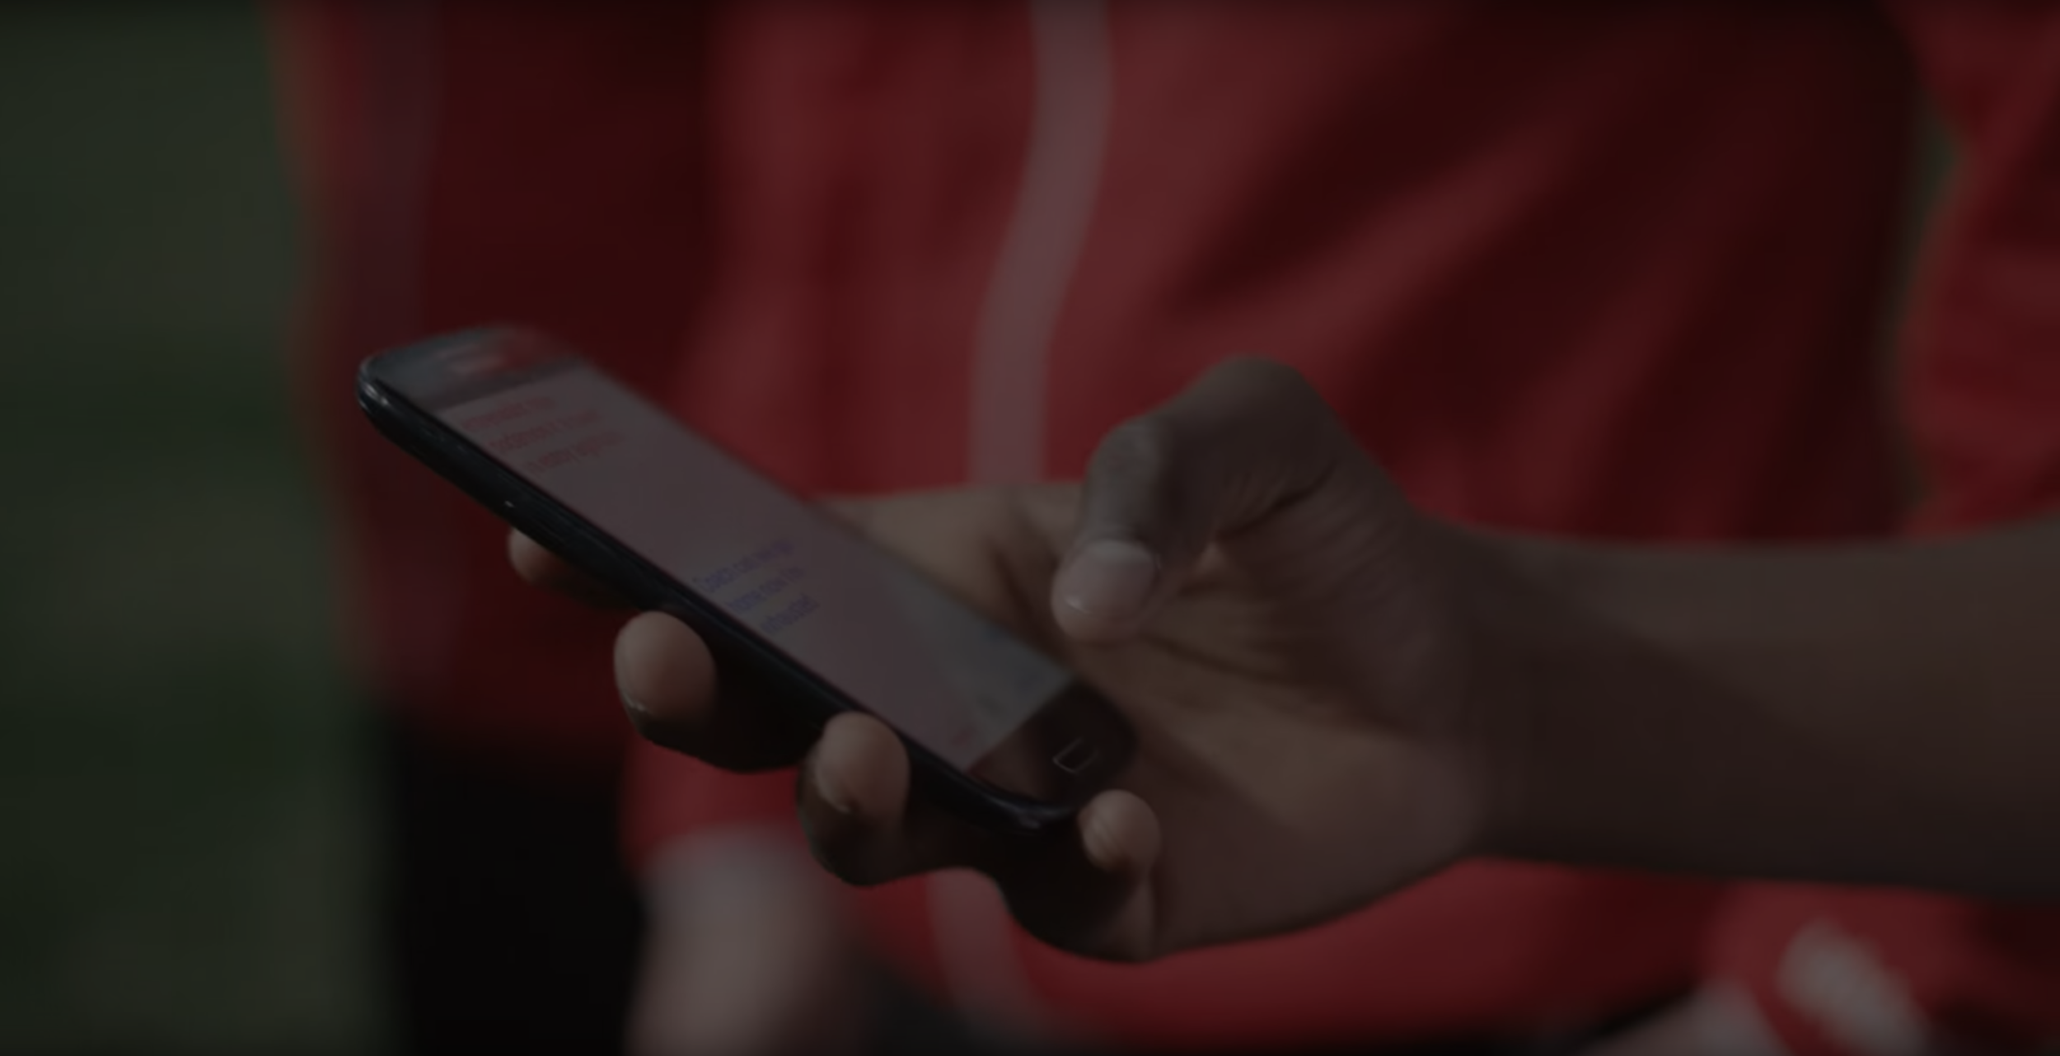
There is always more work and we seem to always be heading towards a deadline or always behind.

Slide 15
Beliefs I Changed
Leaders work long hours.
Leaders are always stressed.
Leaders need to put the needs of stakeholders before themselves

Slide 16
Office Hours: I only work late two days a week and I only work two weekends per quarter.
Alberto scored 30 goals in 21 games. He is now being scouted by several professional clubs in the Premier League. And he’s a favorite of the other boys on the team.
See a short video on Alberto’s story

Slide 17
Take 5 minutes and sketch out a new vision. Then we will discuss.

Slide 18
2. Self-Assessment
Myers Briggs
Strengths Finder 2.0
DISC Assessment

Slide 19
Discussion 1.Have you taken an assessment? What did it say? 2. In what type of environment would you thrive?

Slide 20
I see a PM as someone who adheres to rules, standards, procedures, and protocol. I tend to work independently of the rules and standard operating procedures to just get to the bottom line. They also need to be controlled, deliberate, predictable, and disciplined. I tend to provide teams with moderate structure and work best in roles that have elements of spontaneity and urgency. Where I think I could be helpful to her is that I tend to solve new problems very quickly and assertively and take an active and direct approach to obtain results. I especially like solving new and complex problems. I am also good with working with big teams and motivating others.

Slide 21
Lesson Tell people your vision. Don’t go against your natural tendency.

Slide 22
3. Time Audit
Is there time for new activities and how much?
Am I keeping my commitment to my office hours?
Am I keeping my commitments to my self-care?

Slide 23
Time Audit
Think back to last week.
Three column paper.
Time
Activity
Withdrawal or Deposit

Slide 24
Discussion What did you notice about your day? How does this match up with your vision? Your natural tendencies.

Slide 25
4. Model Calendar (Conditions)
What are my work hours?
What self-care needs to be on the calendar and non-negotiable?
What are my regularly scheduled work commitments?

Slide 26
Office Hours: I only work late two days a week and I only work two weekends per quarter.
Alberto scored 30 goals in 21 games. He is now being scouted by several professional clubs in the Premier League. And he’s a favorite of the other boys on the team.
See a short video on Alberto’s story

Slide 27
4. Model Calendar (Reality)
What else fits o my calendar given my work hours?
What can I delegate?
What can I further negotiate?

Slide 28
Prioritize You Self-care Planning
System
Notes:
I was putting in the wrong type of fuel. I left the car running all night. I didn’t change my oil. I put too many miles on my car. I would do all of the driving. I didn’t take the time to give maps to other people so they share some of the driving.

Slide 29
1. Prioritize Your Vision
Create an inspiring, positive, affirmation statement with a destination.

Slide 30
2. Prioritize Your Awareness
Take yourself off autopilot and understand what’s bringing you joy and what’s causing stress.

Slide 31
3. Prioritize Your Time
Make room for your vision and the things that are most important to you.

Slide 32
4. Prioritize Your Activities
Select self-care activities that directly address what’s stressing you out.

Slide 33
5. Prioritize Your Boundaries
Be very careful to safeguard your life where you are the #1 priority.

Slide 34
Aisha Moore, MPH Self-care by Aisha
aisha@selfcarebyaisha.com
www.selfcarebyaisha.com

