Slide 1
Chanté Coleman
Director of Equity and Justice
National Wildlife Federation
Notes:
Why we are using equity and justice

Slide 2
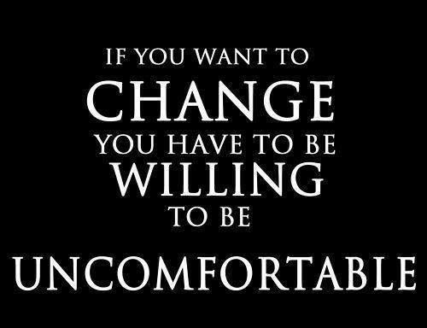

Slide 3
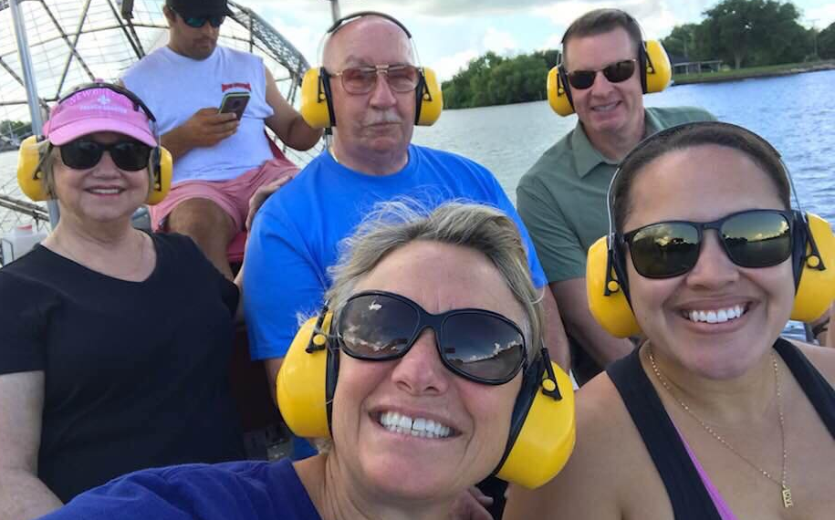
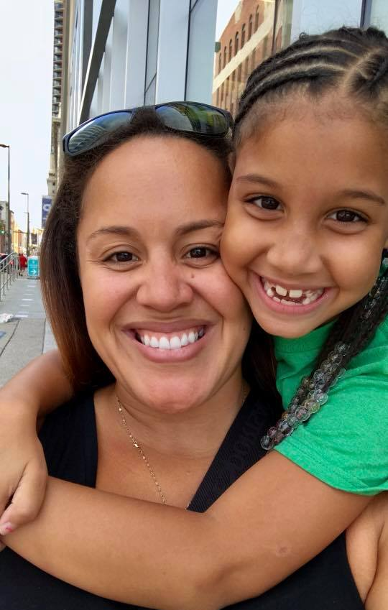

Slide 5
Lack of Diversity
Green 2.0 asked the 40 largest NGOs and environmental foundations to report the ethnic diversity of their staff.
Among the 40 largest green NGOs, only 20% of the staff and 21% of the senior staff identified as People of Color.
Environmental foundations revealed similar numbers with 25% of the staff and 4% of the senior staff identifying as People of Color.
In comparison, more than 40% of staff and 17% of executives in the tech sector are People of Color.

Slide 6
Equity and Justice:
Why, What, How?
Notes:
Why we are using equity and justice

Slide 7
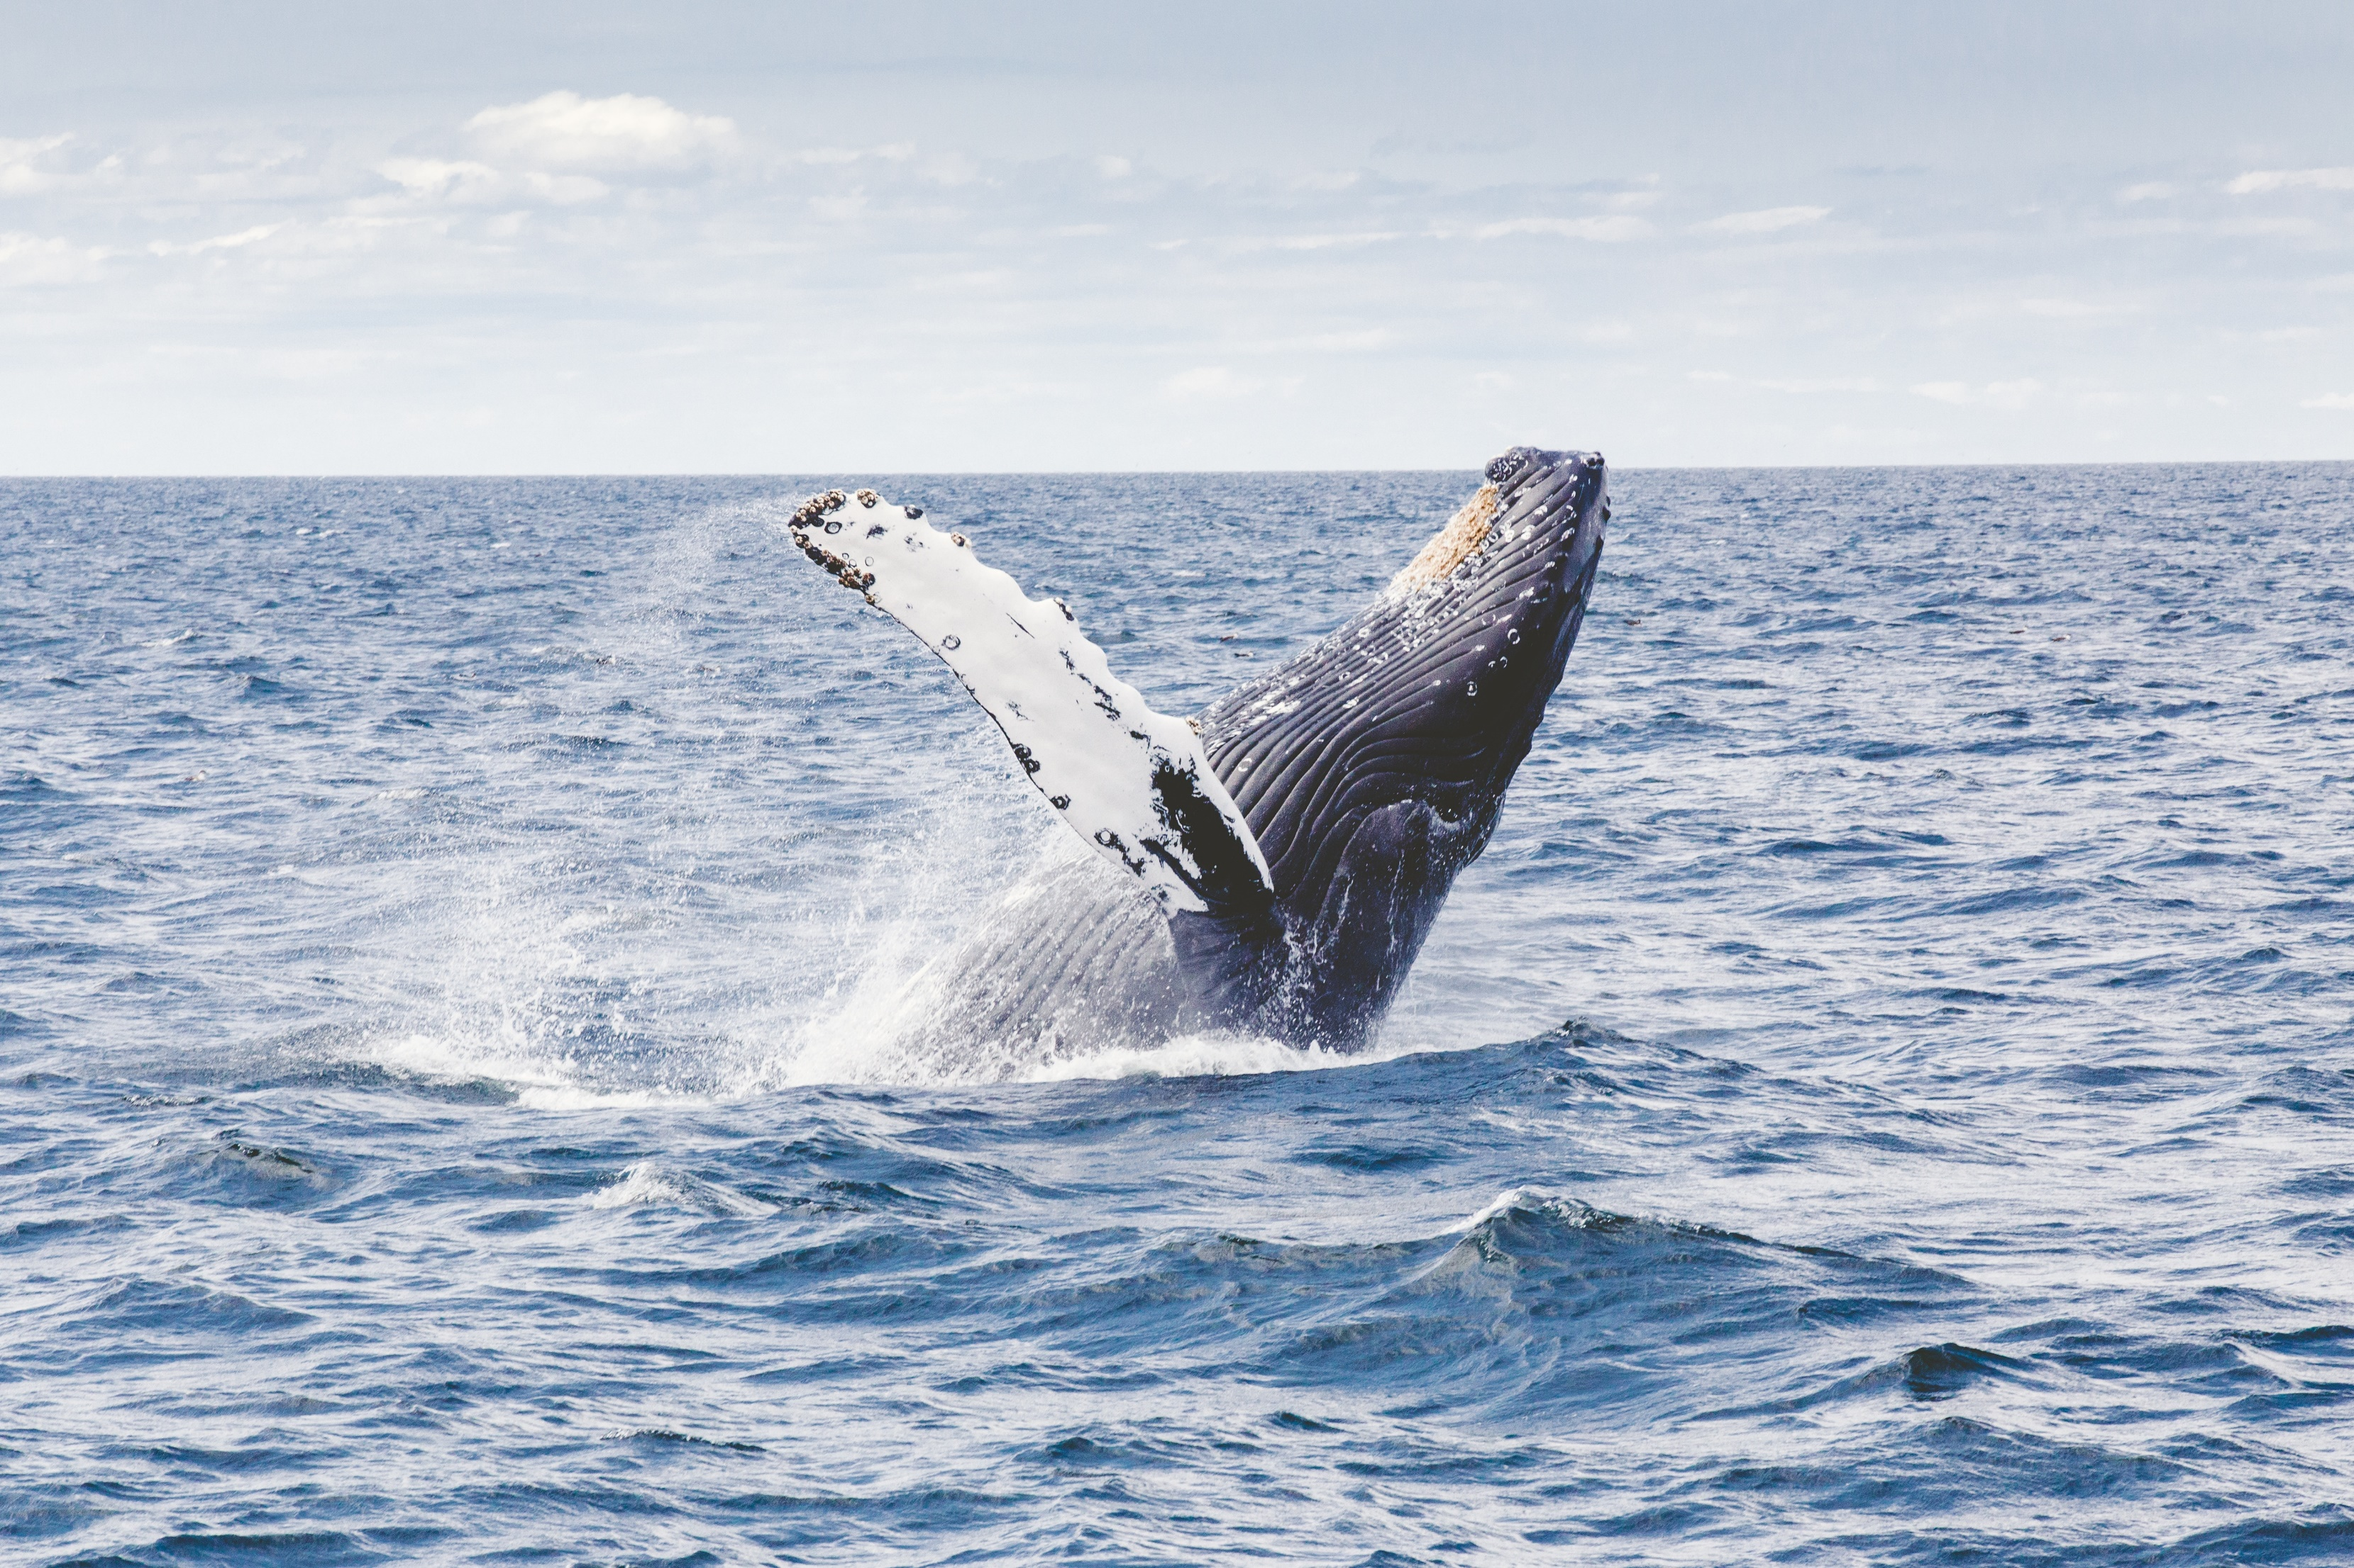
The WHY

Slide 8
Because…
It’s the right thing to do
Higher creativity, productivity, and better decision making
Attract and retain the best talent
Increase relevancy, engage more people
Increased funding

Slide 9
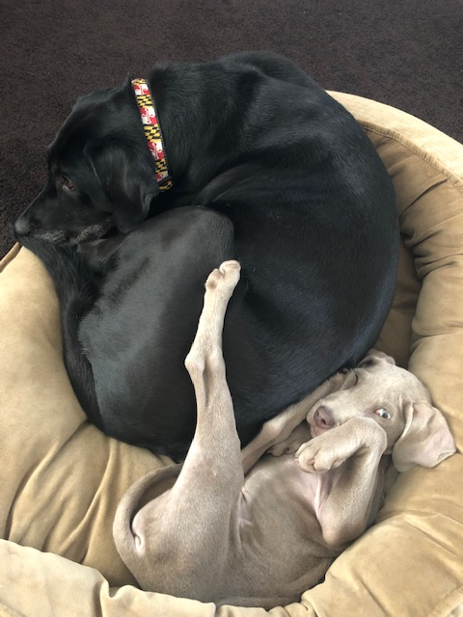

Slide 10
Photo Credit: JOHN HENDRICKSON
The WHAT
Notes:
Chante

Slide 11
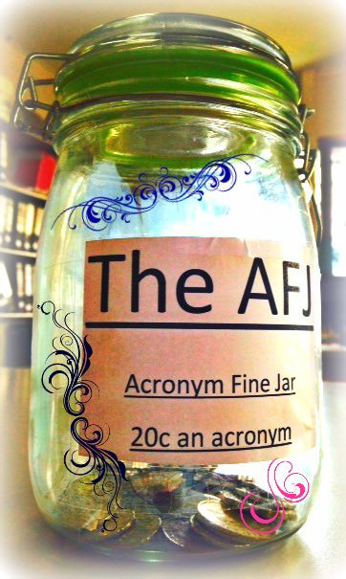
TMDL
NPDES
MS4
CDRW
DEP
DCNR
CWA
DEIJ
JEDI

Slide 12
Equity
Promoting justice, impartiality and fairness within the procedures, processes, and distribution of resources by institutions or systems.
Centering on people with subordinanted (non-dominant) identities a.k.a. people with less power and privilege
Requires an understanding of the underlying or root causes of disparities within our society.

Slide 13
Diversity
Diversity Asks: Equity for Whom
For example: racial and ethnic groups, income, spectrum of built environmental settings (rural to urban), faith communities, LGBTQ+ populations, people with disabilities, gender, relationship to the natural environment

Slide 14
Tips
Avoid saying “diverse person” or “diverse candidate” – a person cannot be diverse
Avoid saying “diverse community” (unless you really mean it)

Slide 15
Inclusion
Refers to the degree to which individuals are able to participate fully in the decision-making process within an organization or group.
While a truly “inclusive” group is necessarily diverse, a “diverse” group may or may not be “inclusive.”

Slide 16
Justice (Social)
Fair outcomes

Slide 18
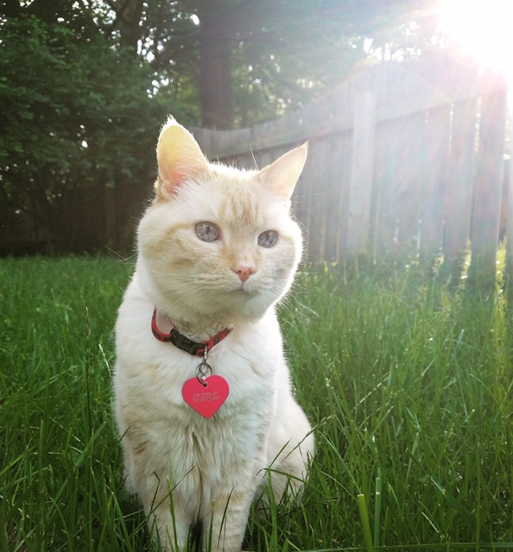

Slide 19
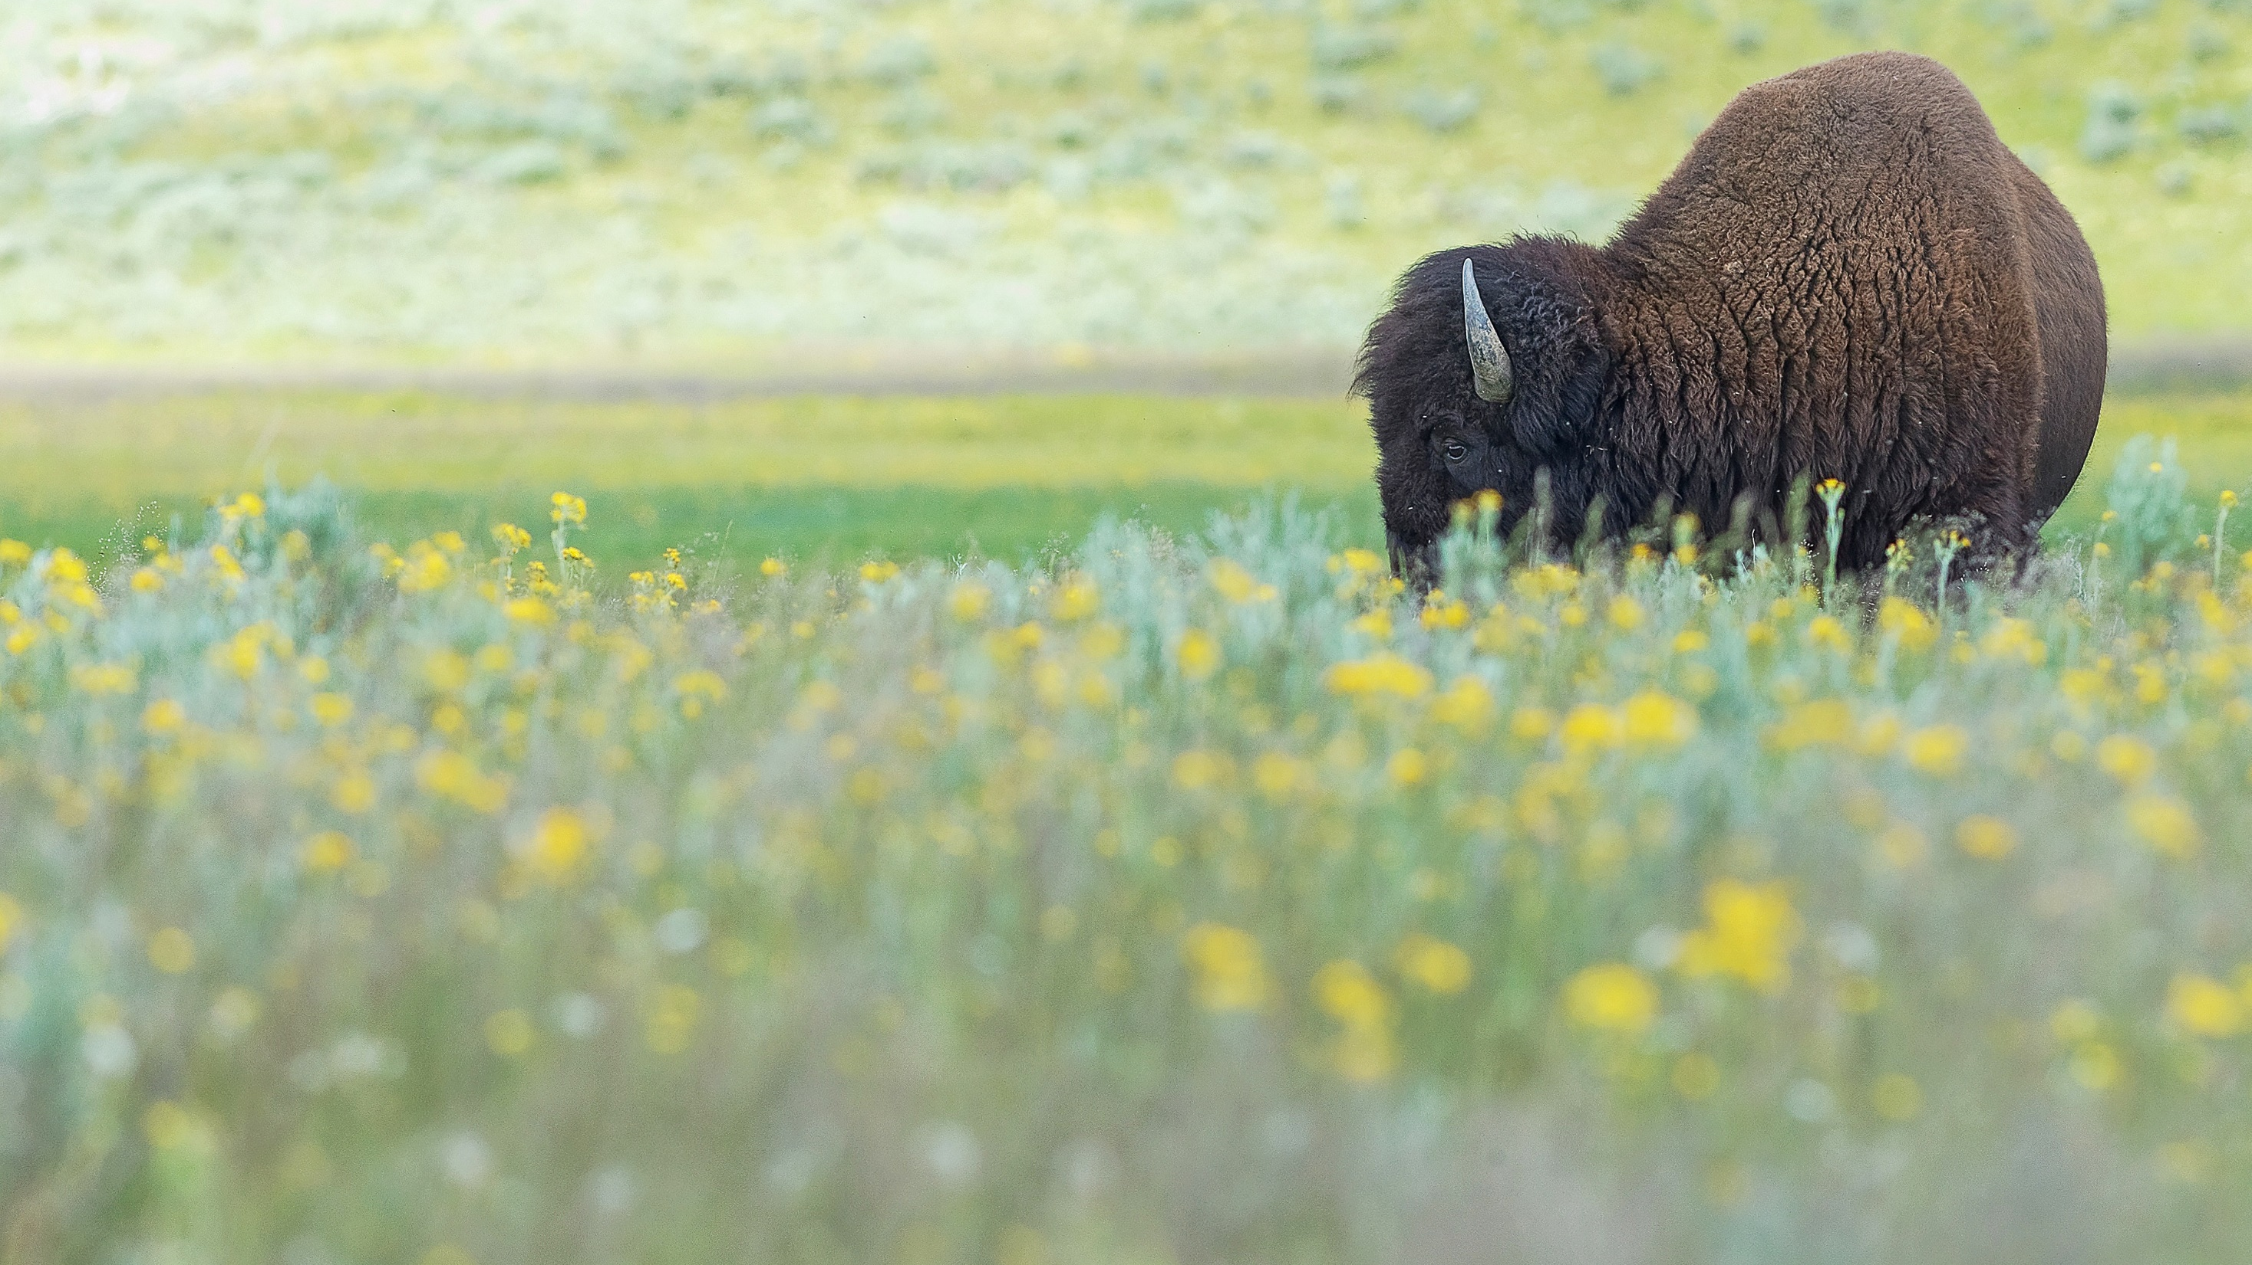
The How
The HOW

Slide 22
Committee
Authority
Resources
Diversity
Center v. Margin
Relationships/Team Building

Slide 23
Chanté Coleman
Office of the President/MARC
Anna Brunner
GLRC
Ryan Fikes
South Central
Equity and Justice
Steering Committee
NORTHERN ROCKIES
Les Welsh
Sharon London
Co-Leaders
Amanda McKnight
April Bowen
Brandon Miller
Jennifer Hammonds
Josh Falk
Paul Harper
Kevin Coyle
Elysia Phekoo-Chewning
Sanaa Unus
Jenni Lopez
Keith Ward
ROCKY MOUNTAINS
Allen Cooper
Andrea Auguiste
Garrit Voggesser
Marisa Sandoval
Max Broad
Jessica Ordonez-Lancet
Samantha Lockhart
HEAD QUARTERS
NAC
GREAT LAKES
CALIFORNIA
Andy Buchsbaum
Elizabeth Lillard
Manja Holland
Beth Pratt-Bergstrom
SOUTH CENTRAL
NORTHEAST
MID-ATLANTIC
Faye Matthews
Brook Randolph
Heather Davis
Amber Hewett

Slide 24
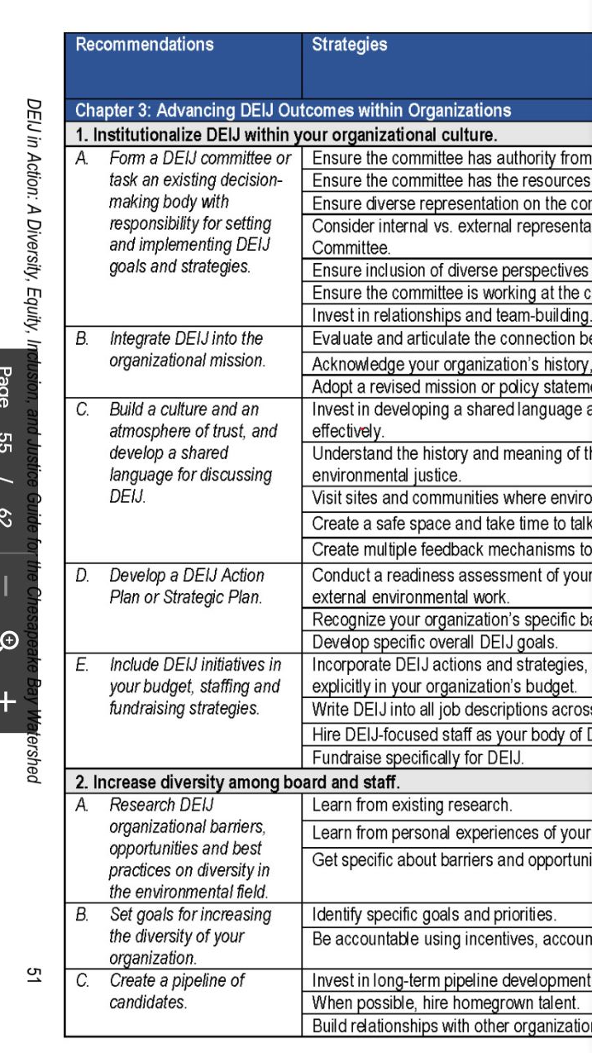

Slide 26
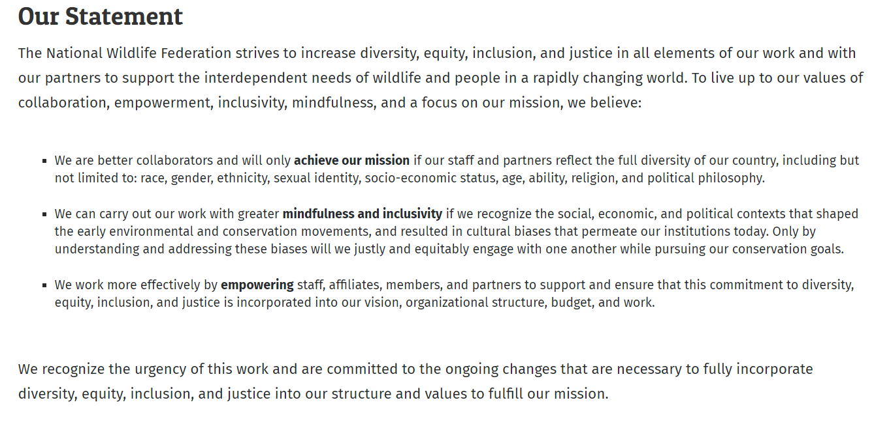

Slide 27
Learning
Unconscious Bias
Group Identity
Anti-oppression

Slide 28
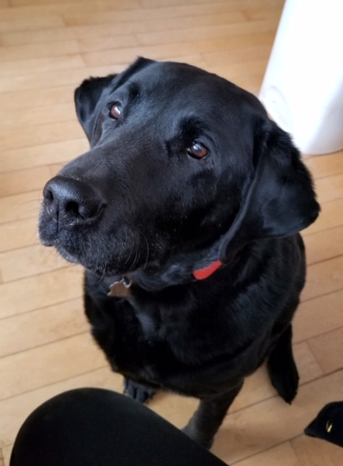

Slide 29
Budget and Staffing

Slide 30
Board
Get your board on board!

Slide 31
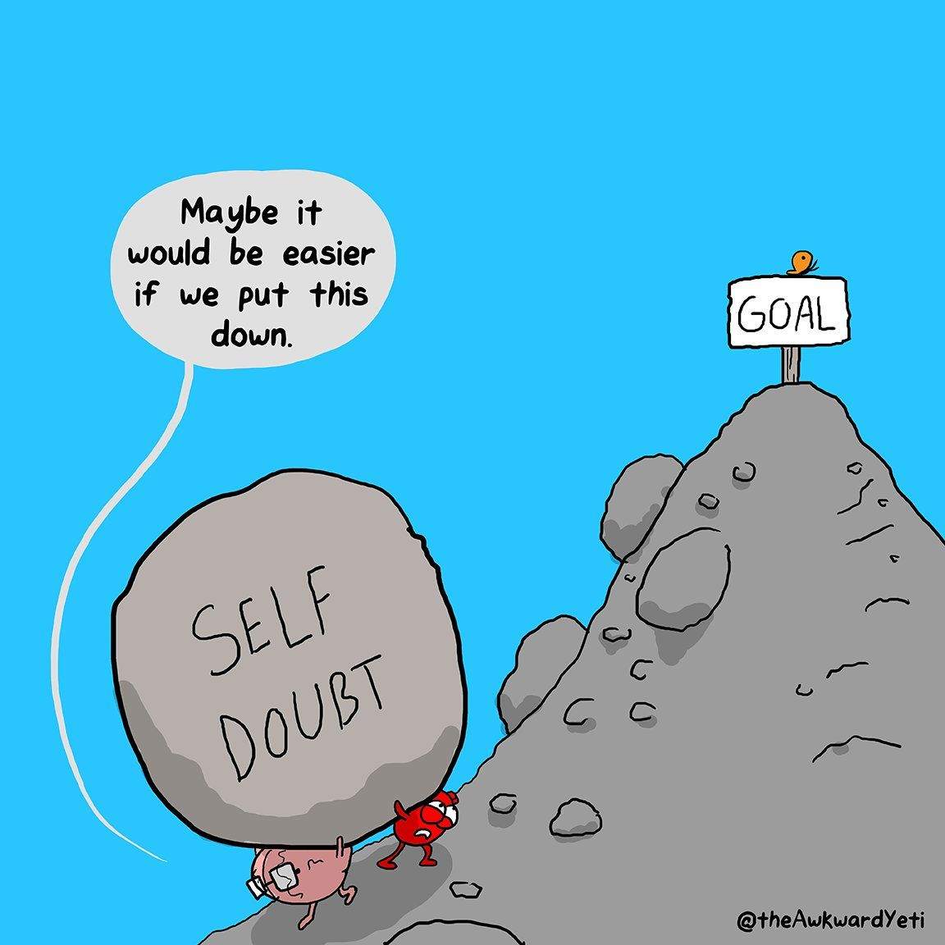

Slide 32
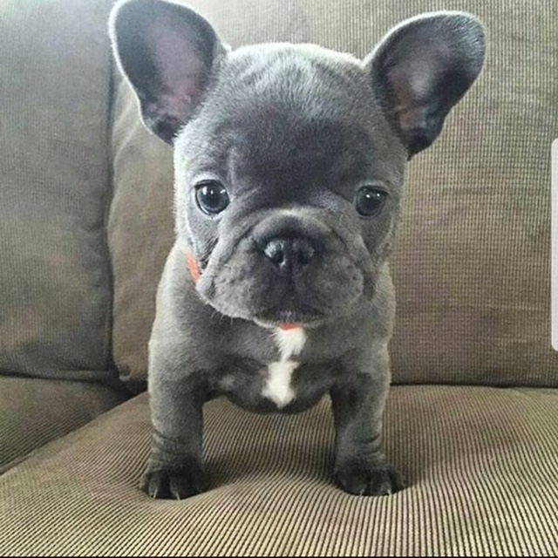

Slide 33
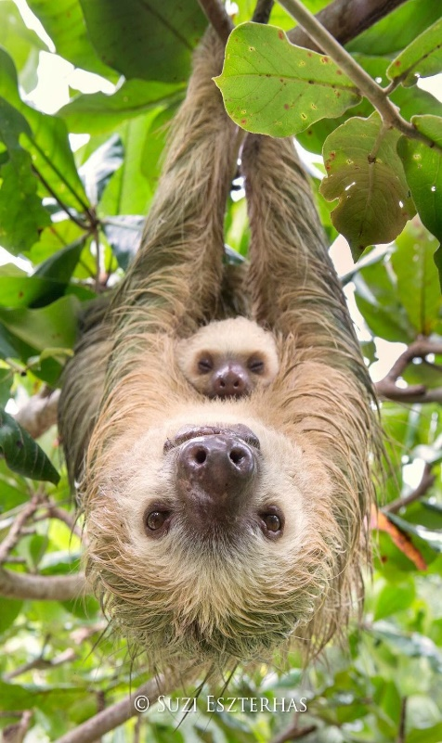
Super Sloth

Slide 34
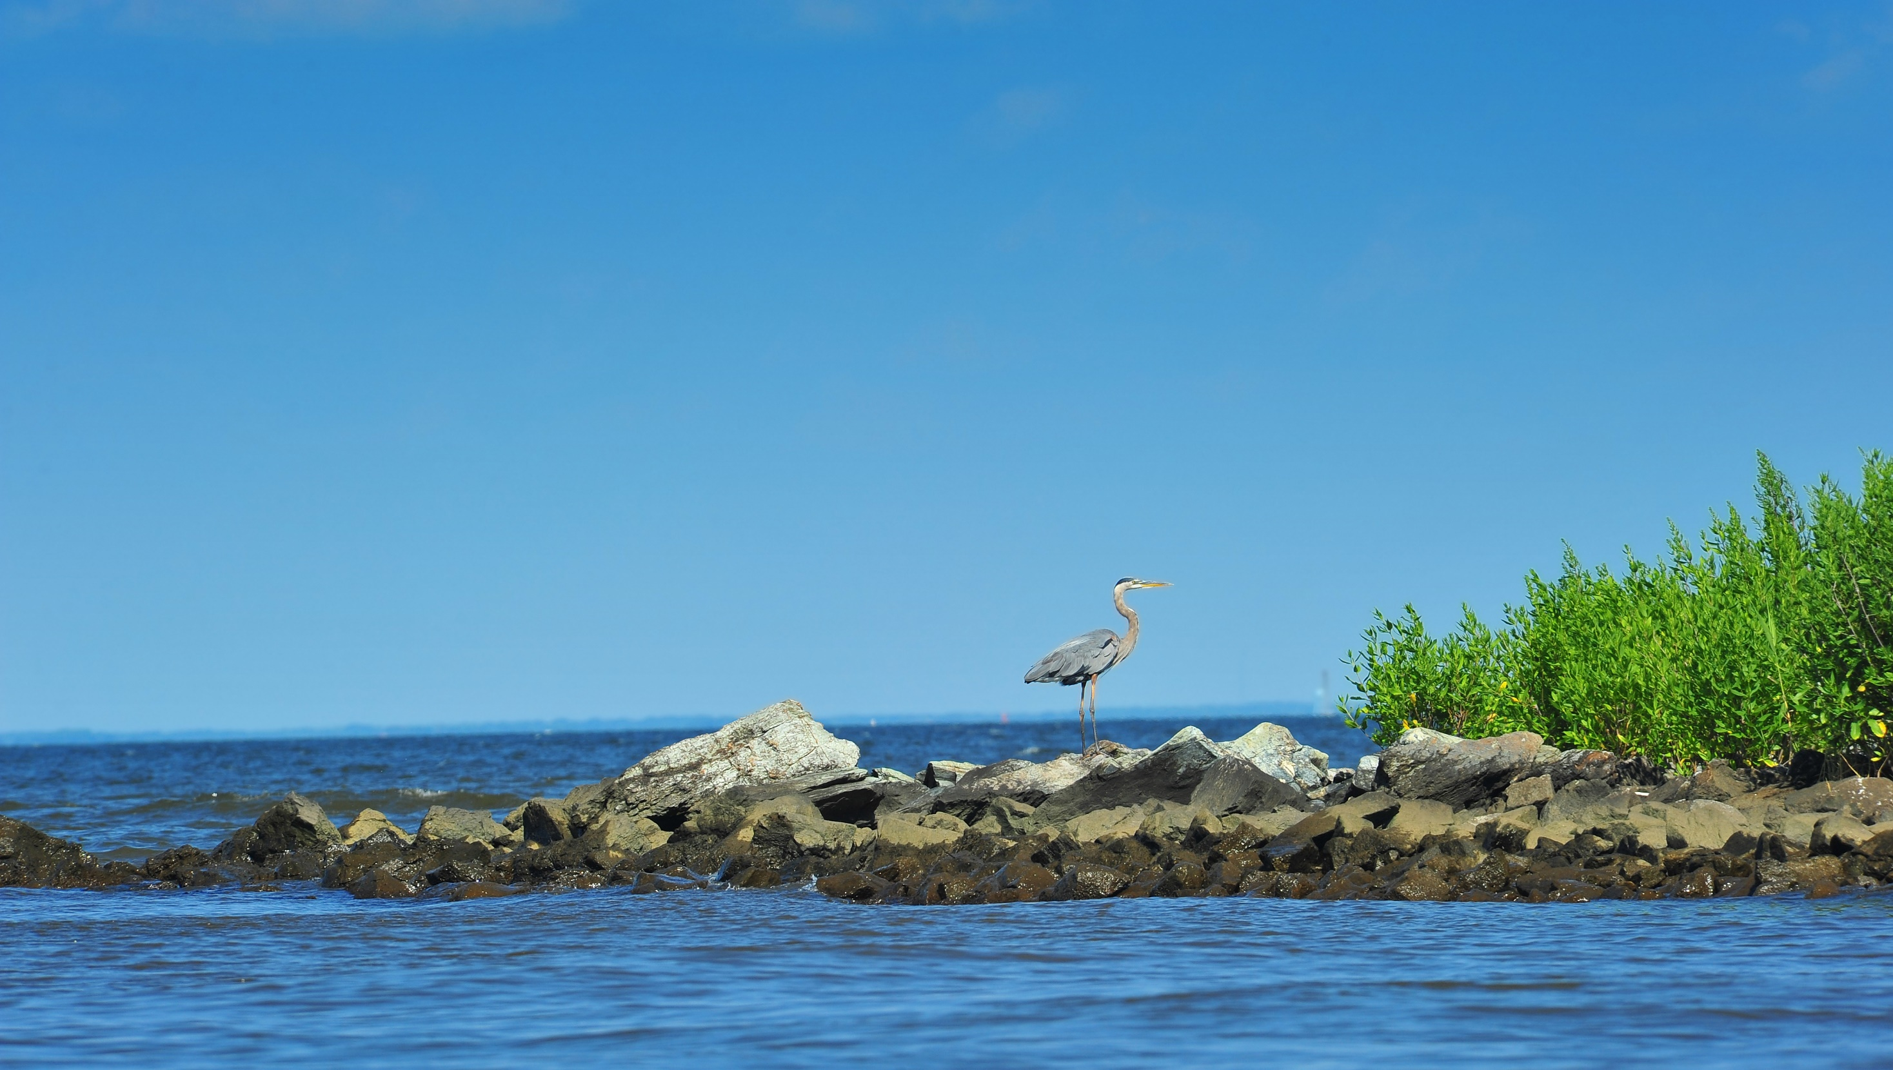
Photo Credit: SHUTTERSTOCK

