Slide 1
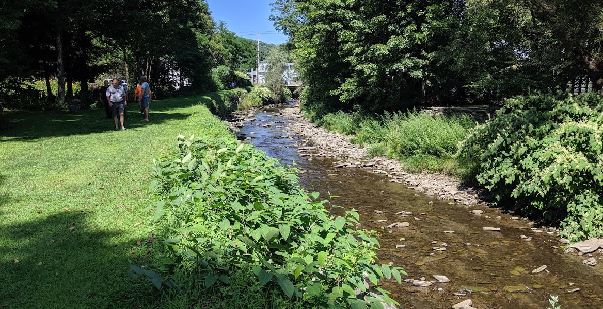
Town of Colchester, NY
Projects along the East Branch of the Delaware River and Downs Brook

Slide 2
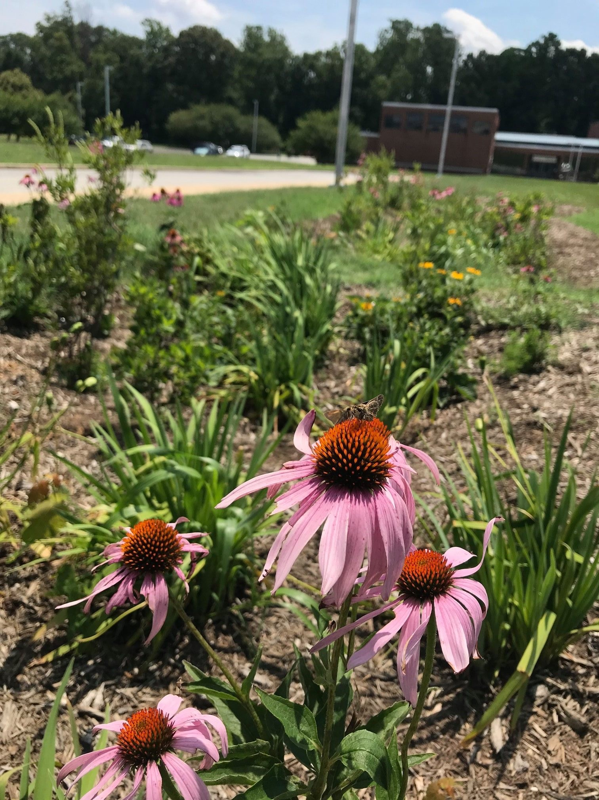
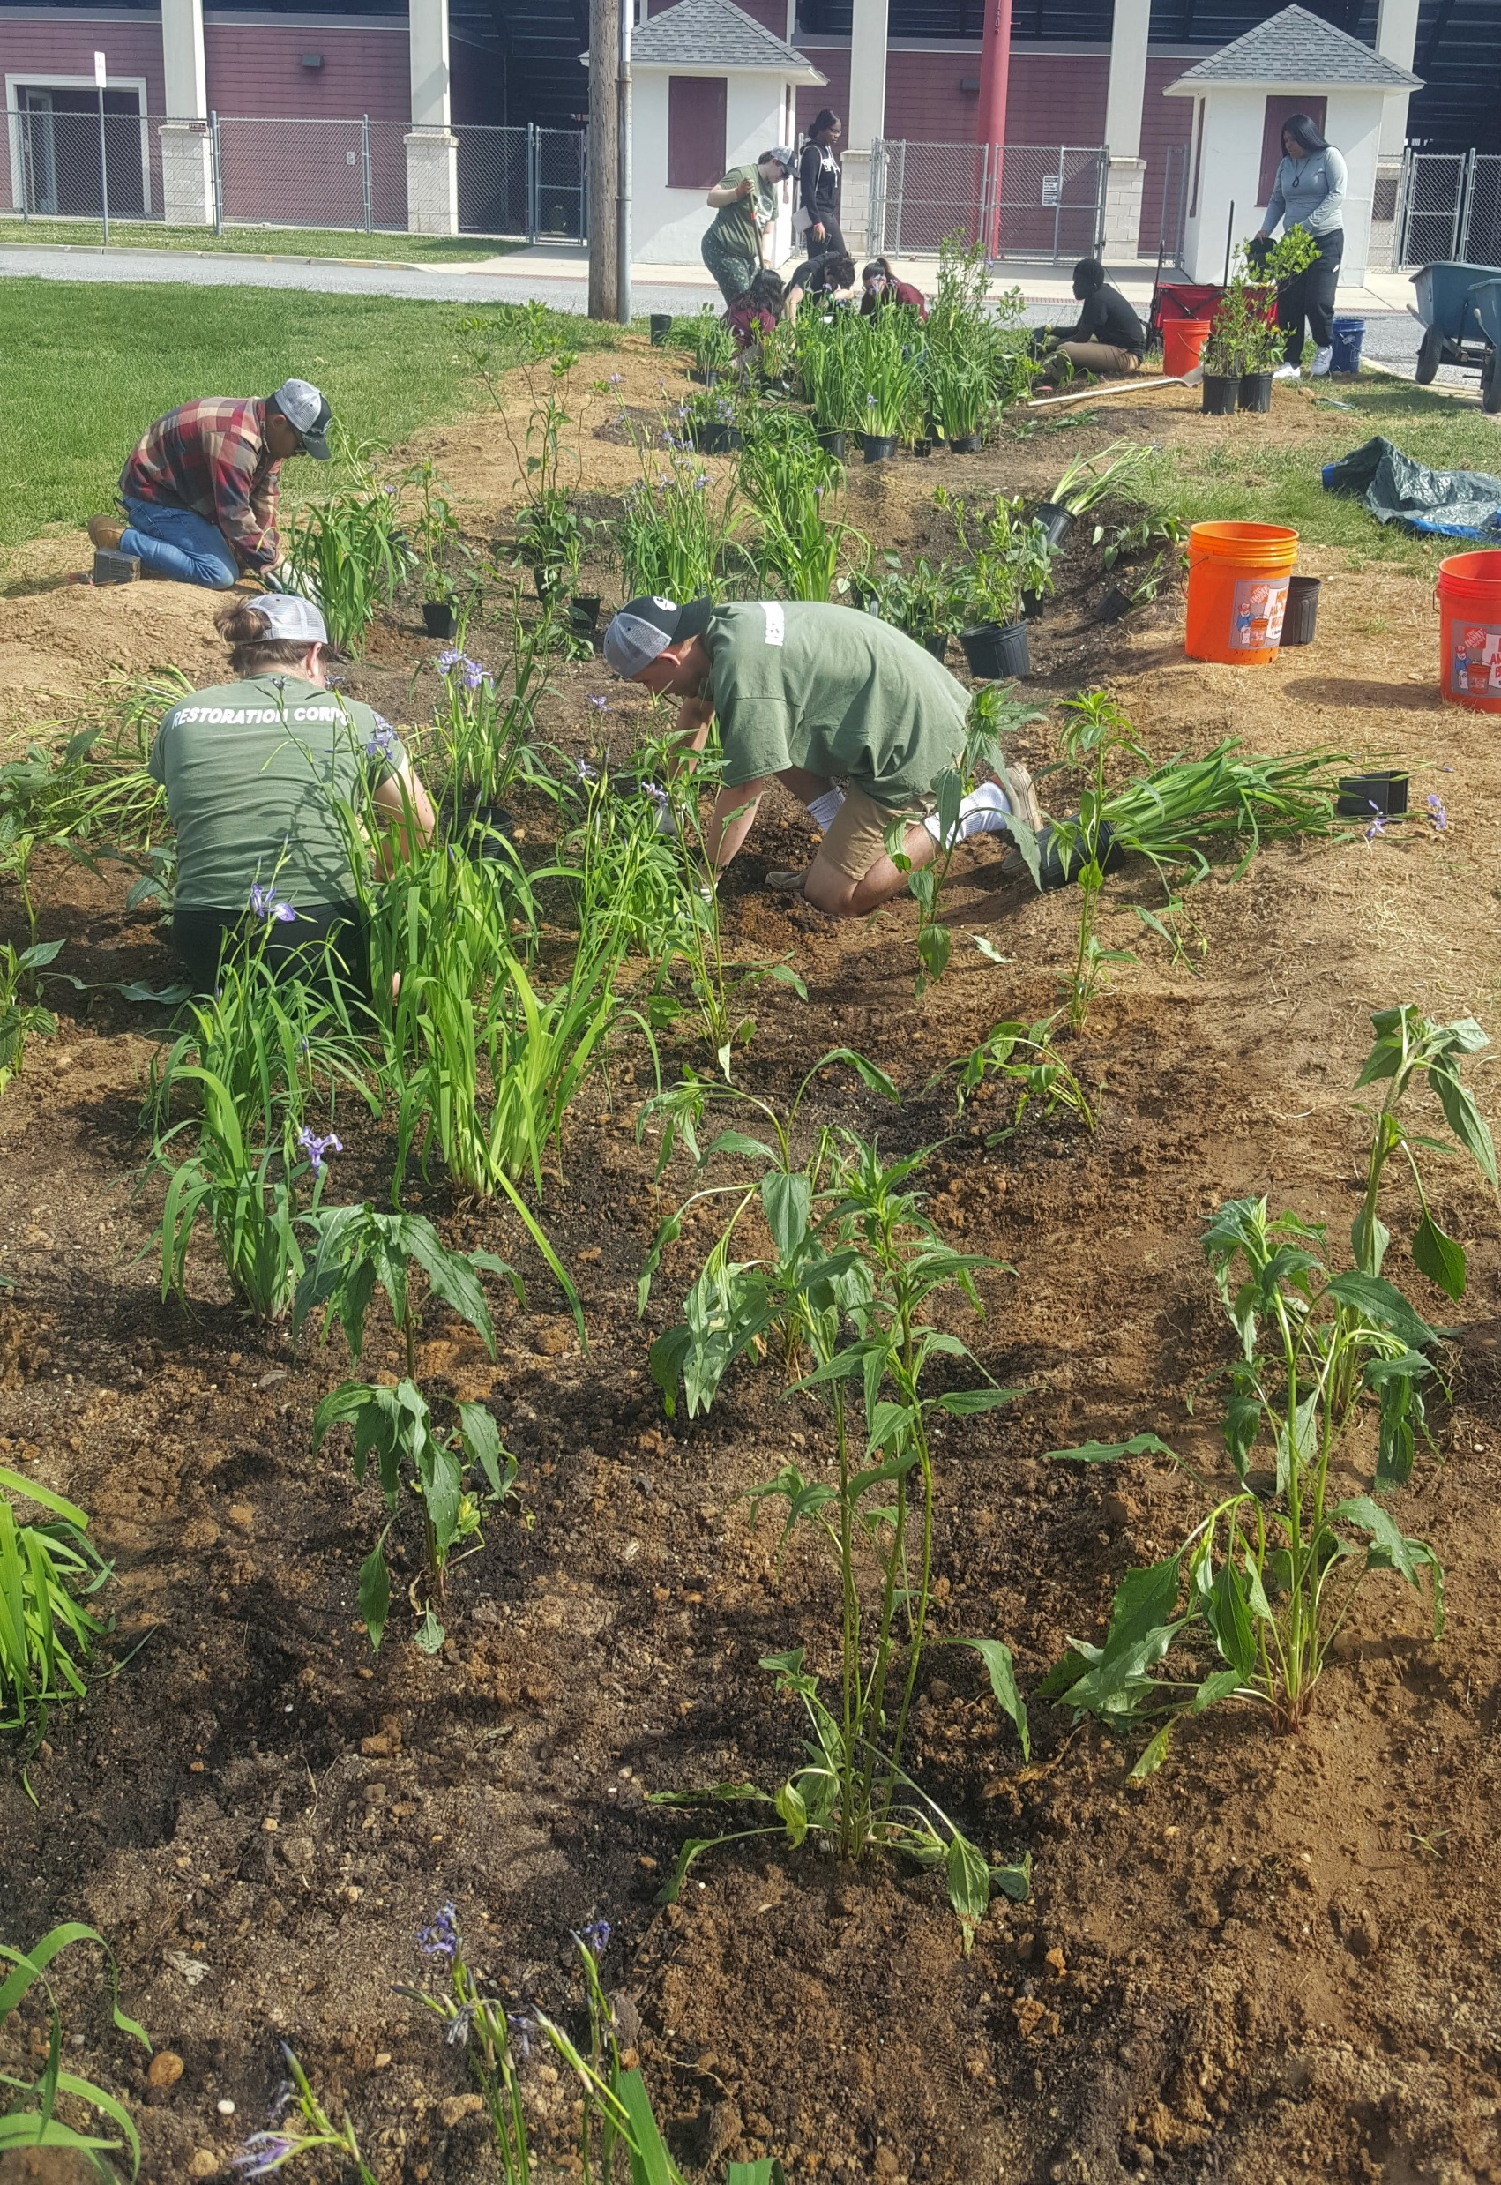
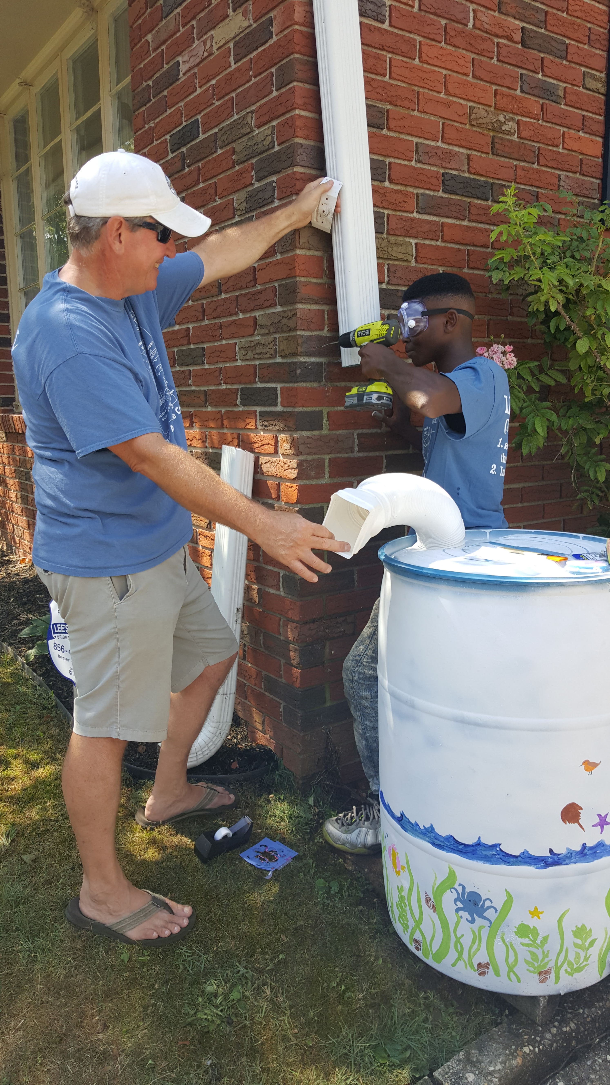
City of Bridgeton, NJ
Projects to improve the water quality in the Cohansey River

Slide 3
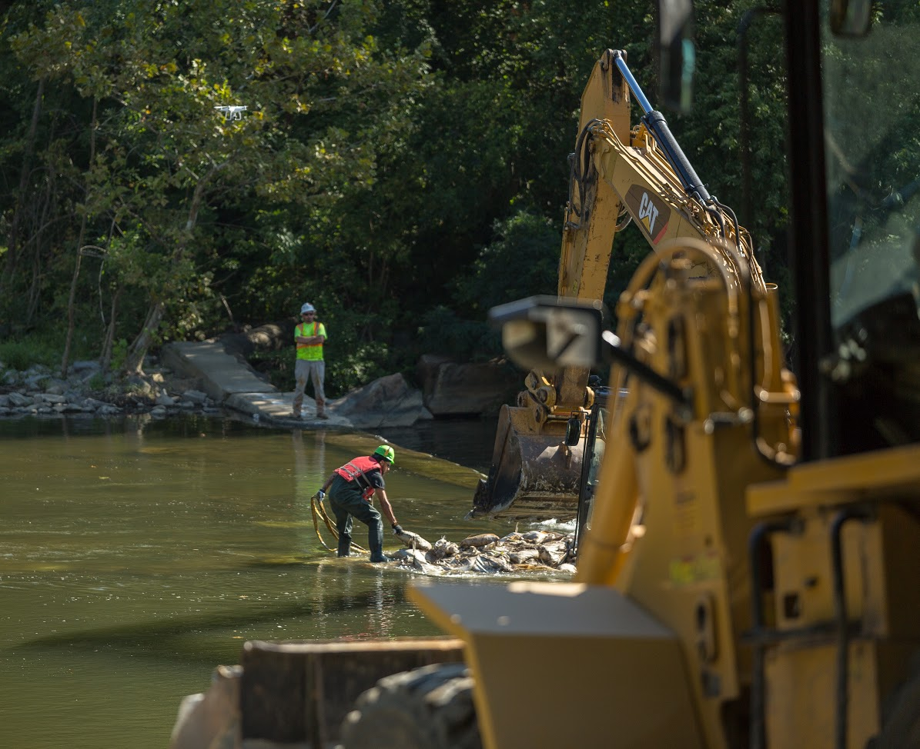
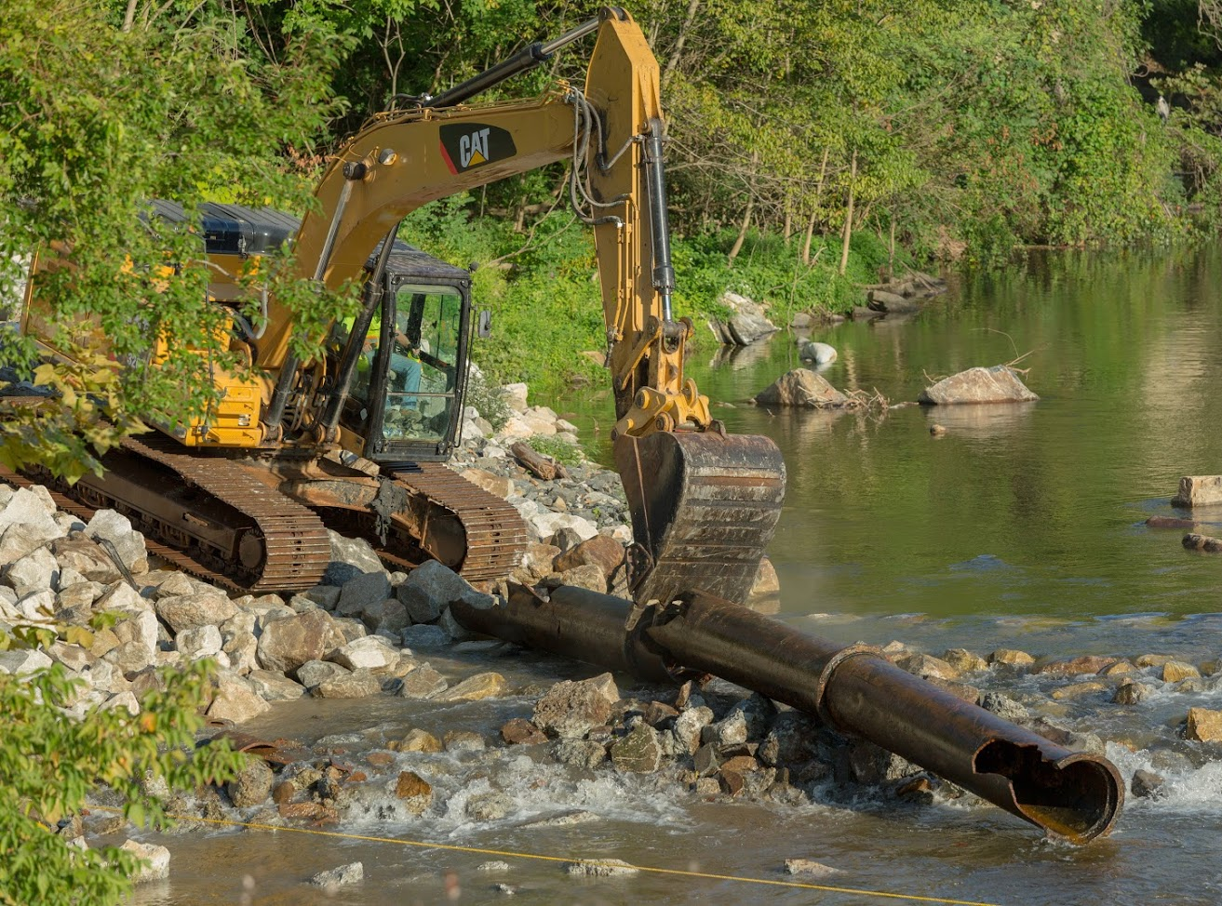
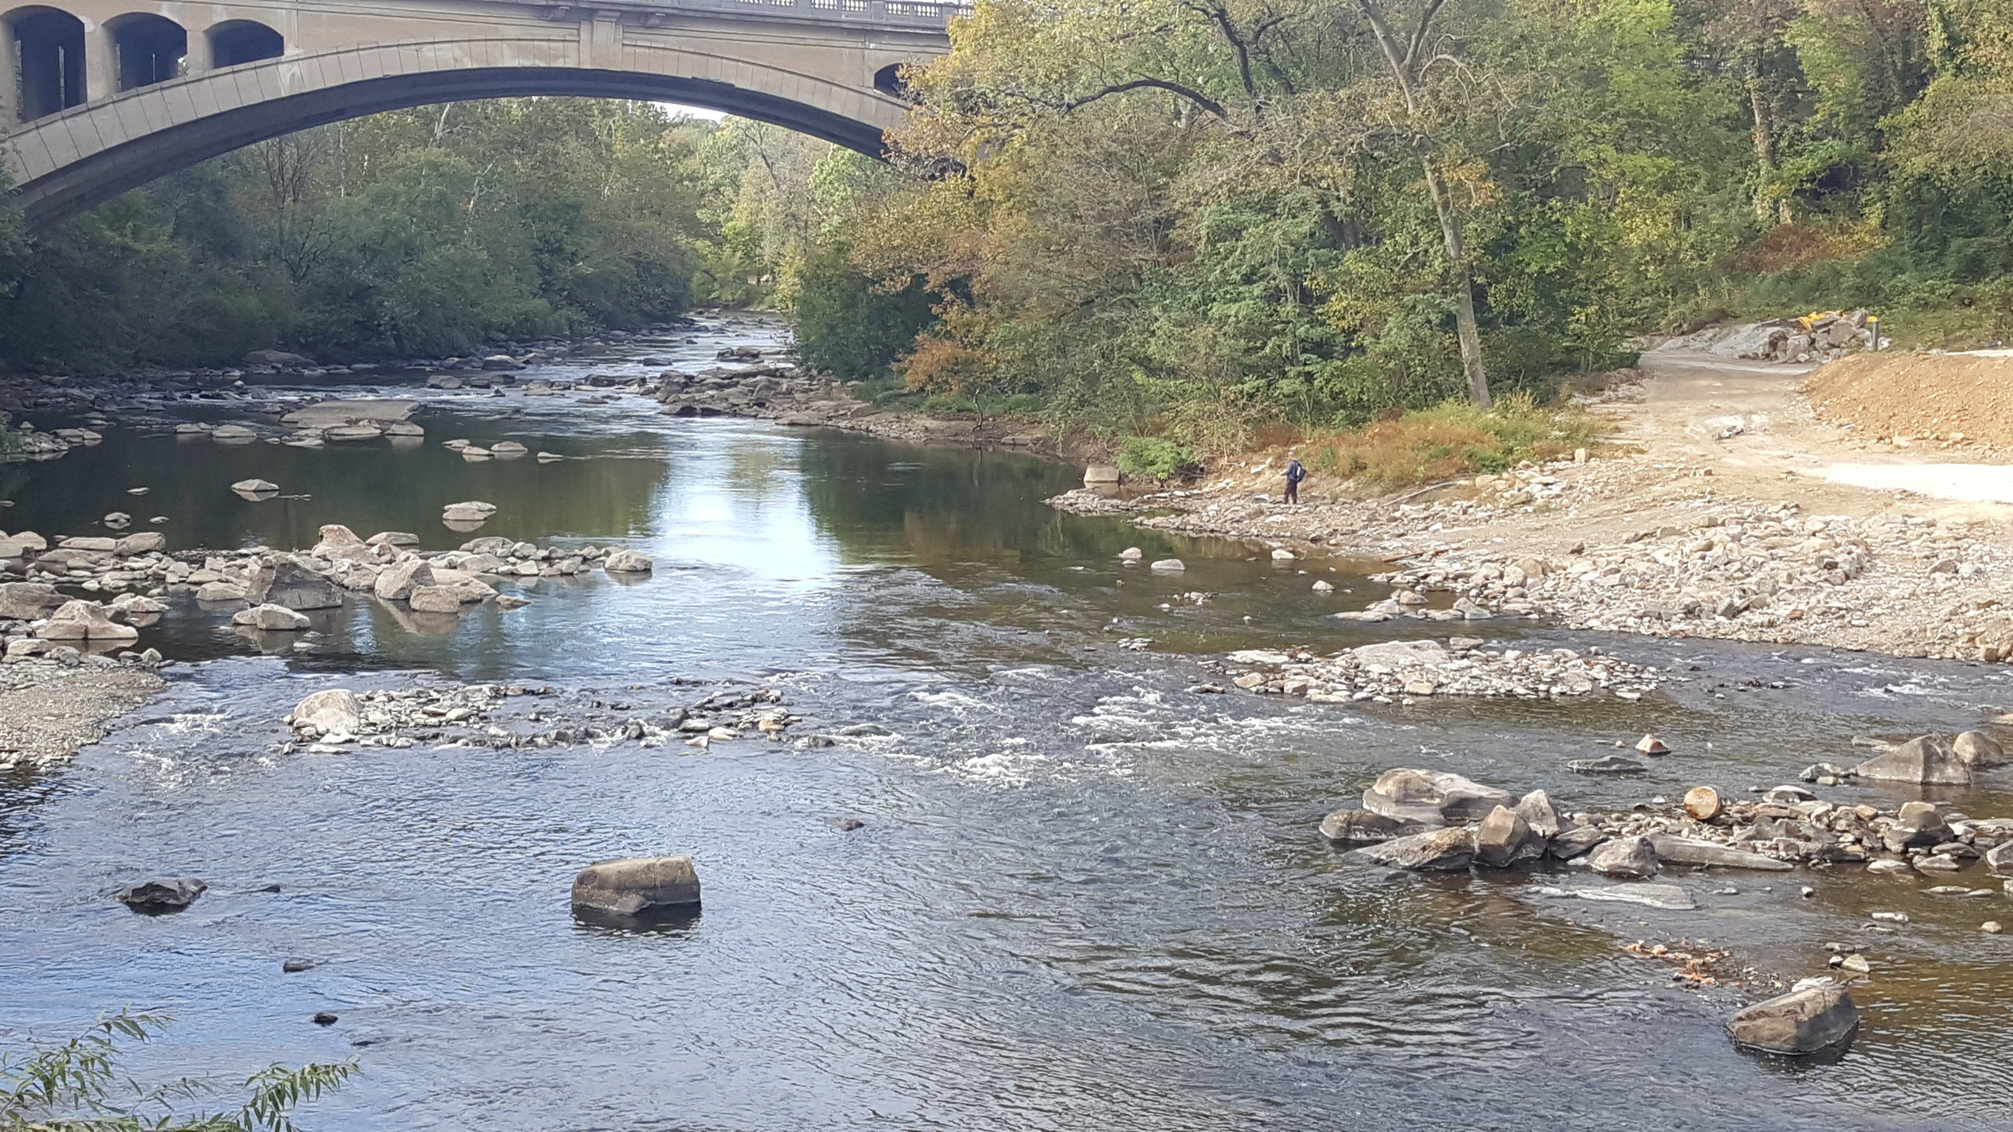
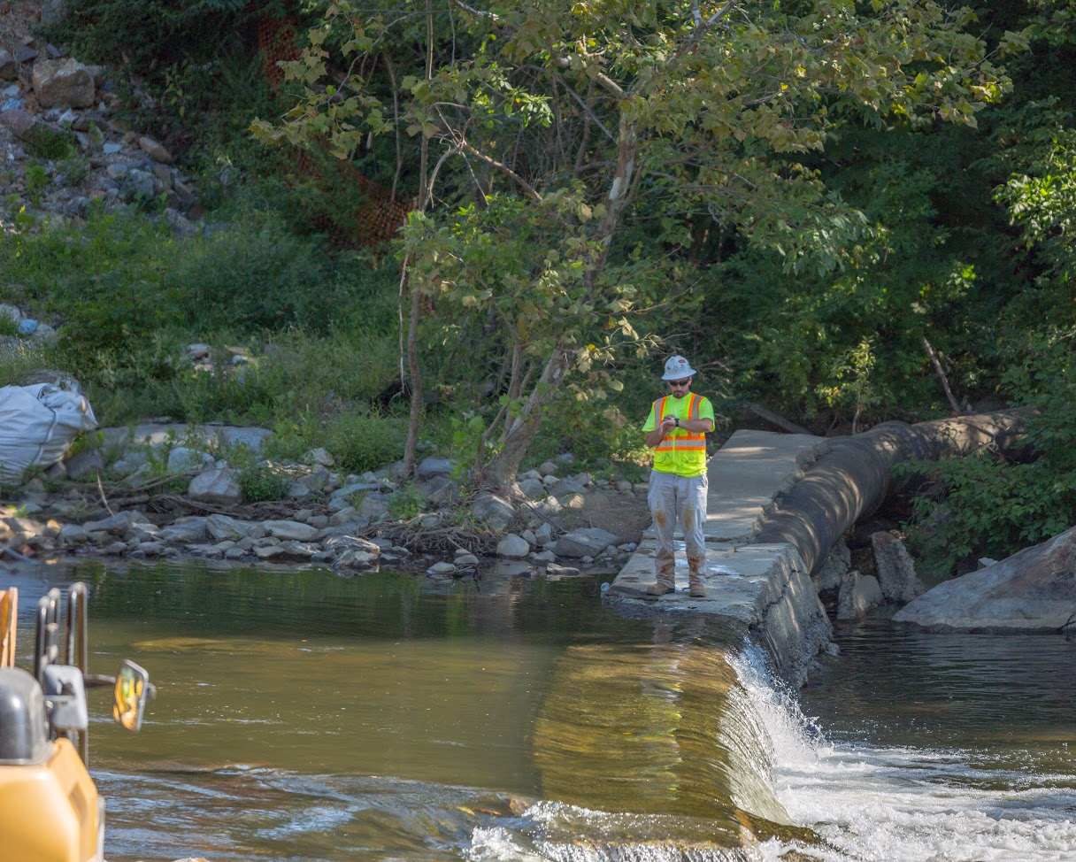
City of Wilmington, DE
South Wilmington Wetlands Park and Dams on Brandywine River

Slide 4
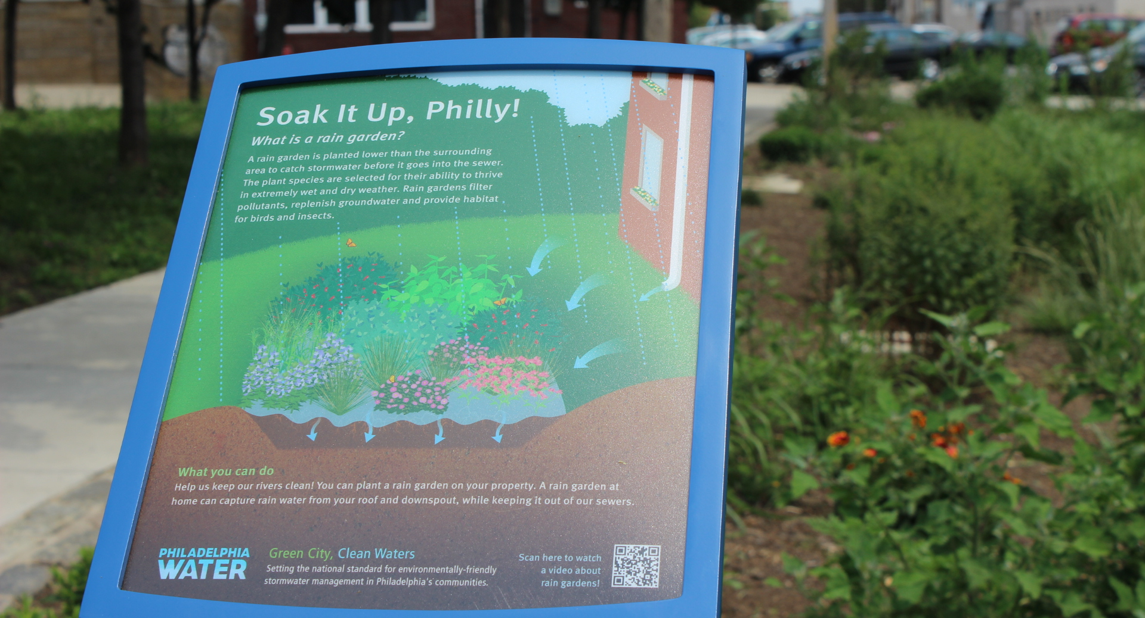
City of Philadelphia, PA
Green City, Clean Waters program

Slide 5
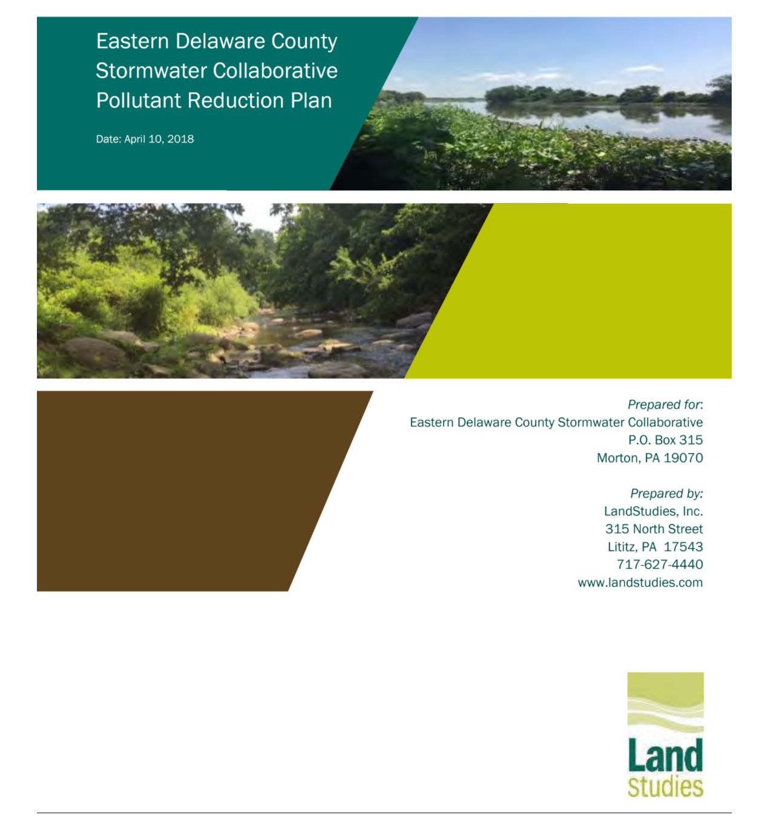
Eastern Delaware
County Stormwater
Collaborative
Joint Pollutant Reduction Plan

