Slide 1
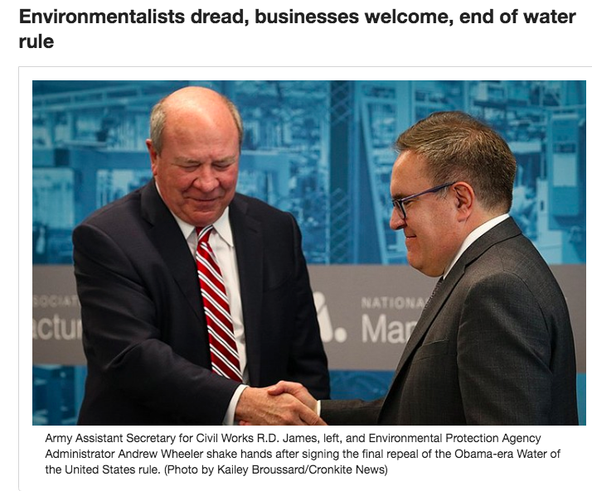

Slide 2
Jobs
Economic Growth
Environment
Clean Water

Slide 3
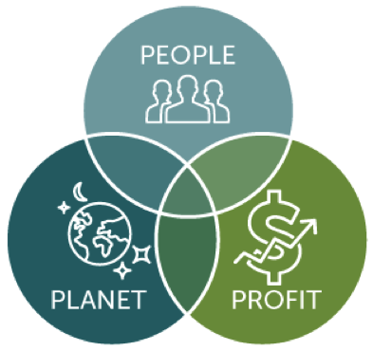
When we try to pick out anything by itself, we find it hitched to everything else in the universe. – John Muir
Triple Bottom-line

Slide 4
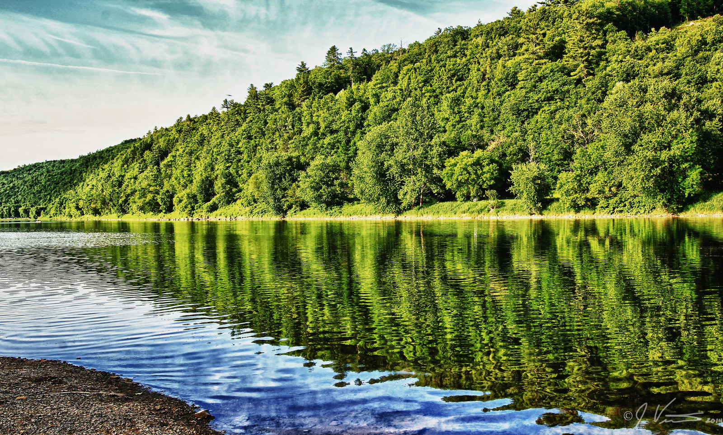
S a
Advancing market and policy solutions for a more vibrant, sustainable and equitable economy
Clean Water is Good for Business

Slide 6
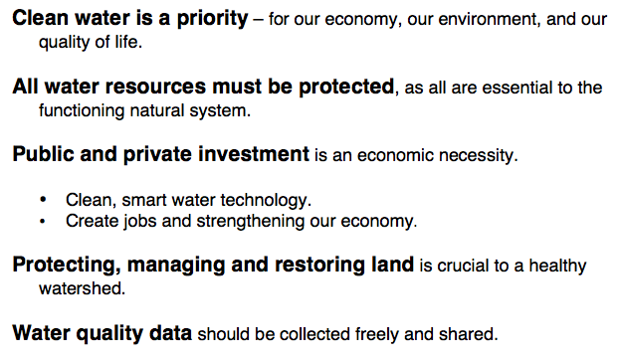
Statement of Principles
We believe….

Slide 7
Partnerships + Collective Impact
Find the latent connections
Seek alignment + diversity
Work within current scope
Leverage/amplify strengths
OpEds
Events and webinars
Outreach, education, social media
Technological/market solutions
Policy change

Slide 8
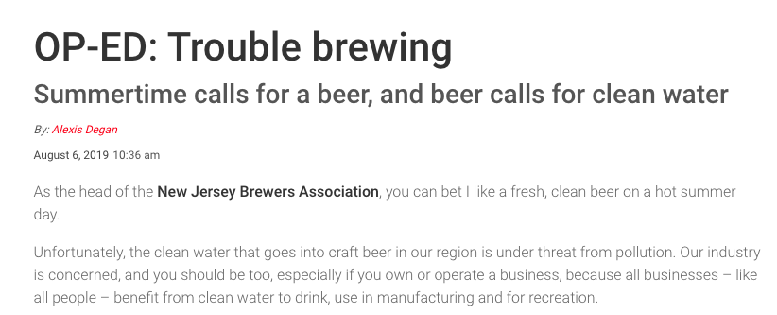

Slide 9
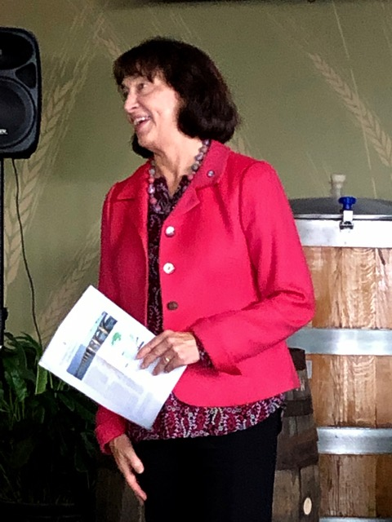
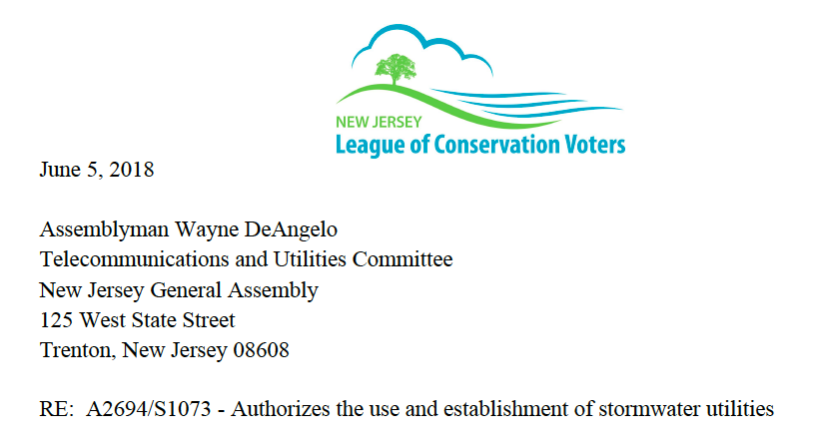
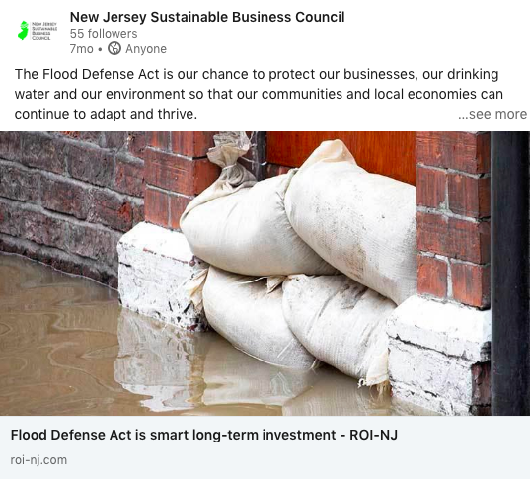
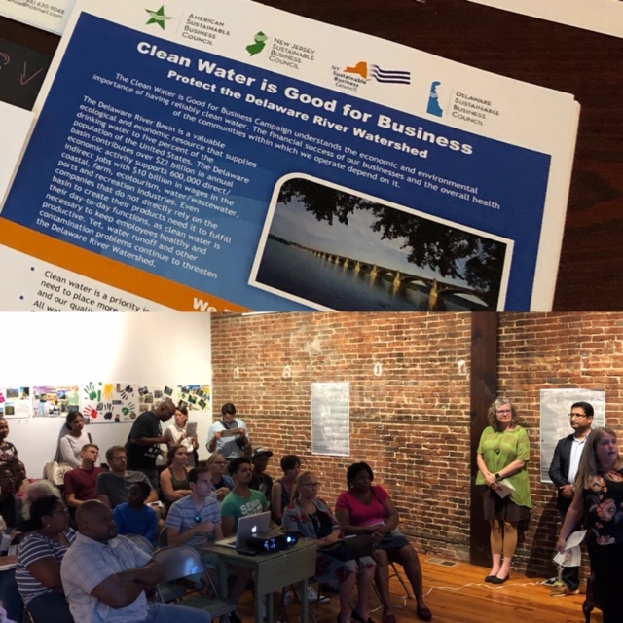

Slide 10
Lessons (still being) learned
Turnover happens
Clear goals, roles, guiding principles
Structure and flexibility
Find the golden mean
Conference calls and group work
One-on-one calls tied to core strategy
Think like an emergent complex system
Stay focused on the mission and goals
Be open to novel ways of actualizing them

