Slide 1
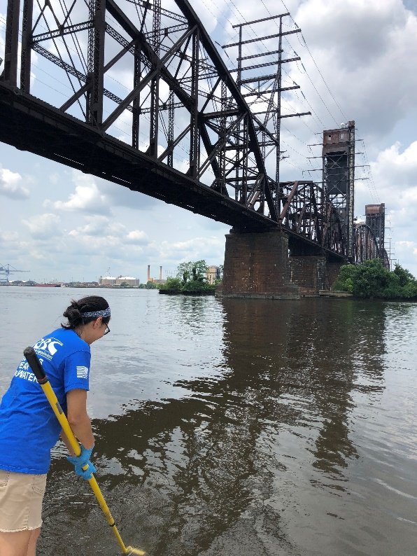
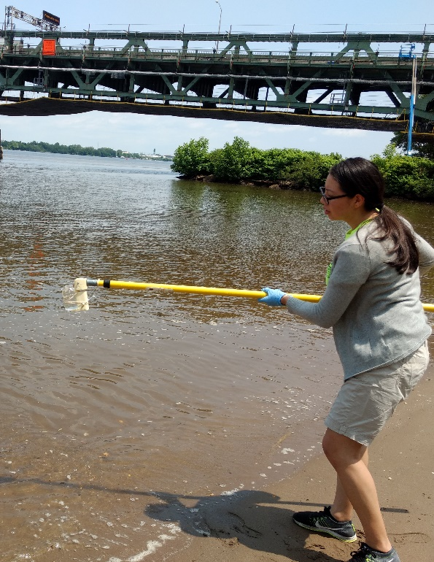
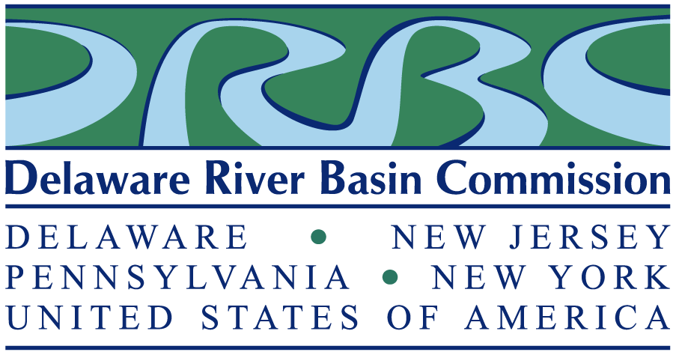
Delaware River Basin Commission
Recreational Uses & Criteria in the Delaware River
Delaware River Watershed Forum
October 16-17, 2019
Allentown, PA
John Yagecic, PE
Manager, Water Quality Assessment DRBC

Slide 2
Delaware River Basin Commission
Broad Responsibilities / Authorities
Water Supply
Drought Management
Flood Loss Reduction
Water Quality
Establish Water Quality Standards
Monitoring & Assessment
Assimilative Capacity Determination
Watershed Planning
Regulatory Review (Permitting)
Outreach/Education
Recreation
Compact signed 1961
Equal Members:
Delaware
New Jersey
Pennsylvania
New York
Federal Government

Slide 3
Water Quality Management Zones
WQM zone | Location (River Mile) | Tidal / Non-tidal
1A | 330.7 – 289.9 | Non-tidal
1B | 289.9 – 254.75 | Non-tidal
1C | 254.75 – 217.0 | Non-tidal
1D | 217.0 – 183.66 | Non-tidal
1E | 183.66 – 133.4 | Non-tidal
2 | 133.4 – 108.4 | Tidal
3 | 108.4 – 95.0 | Tidal
4 | 95.0 – 78.8 | Tidal
5 | 78.8 – 48.2 | Tidal
6 | 48.2 – 0.0 | Tidal

Slide 4
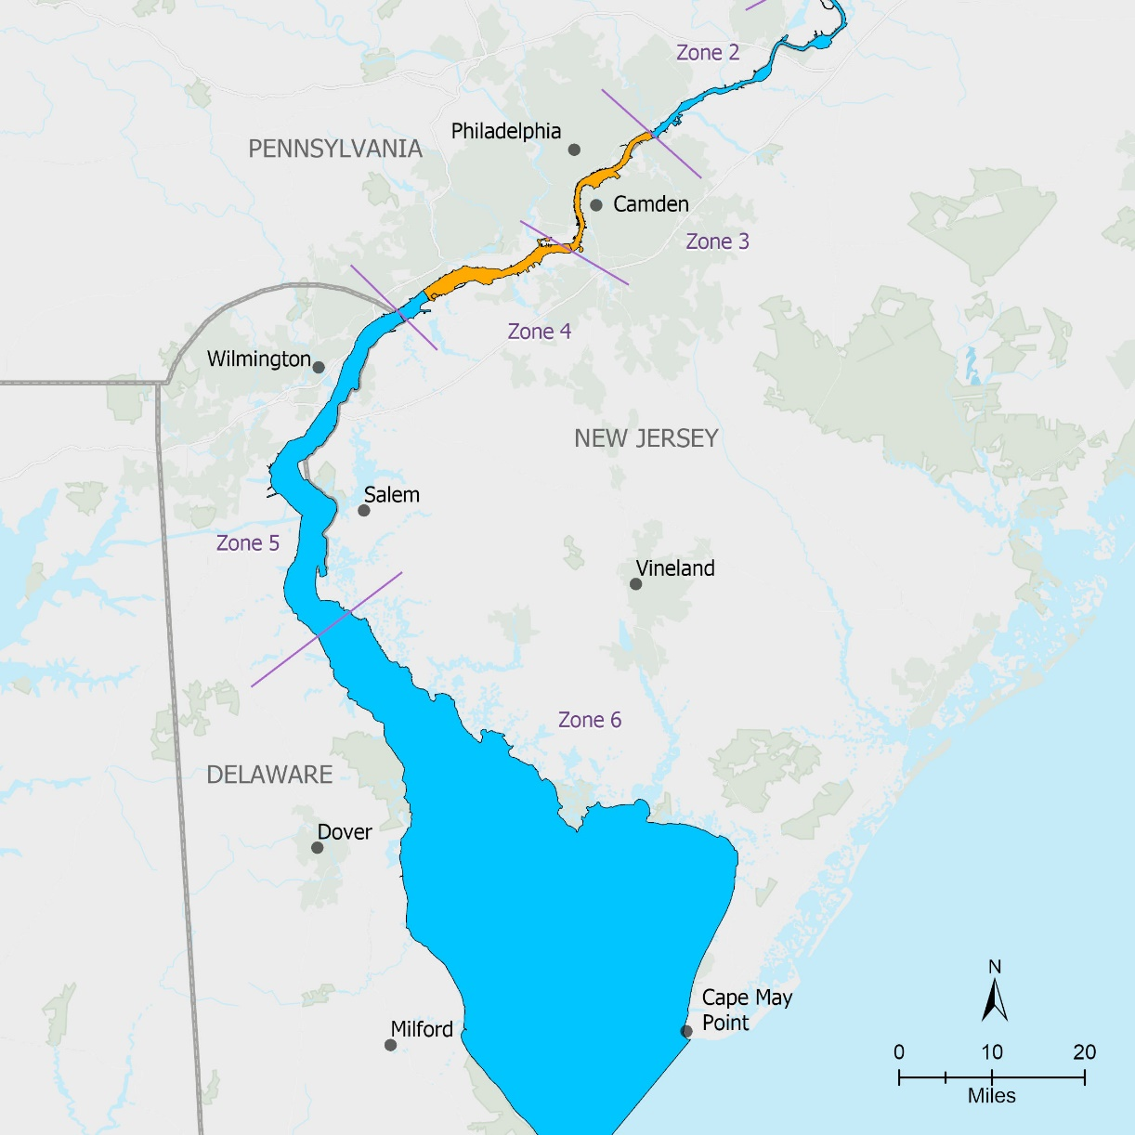
Current Recreational Uses / Criteria in Delaware Estuary (DRBC WQ Regs)
http://www.nj.gov/drbc/library/documents/WQregs.pdf
Zone | Use | Fecal Coliform | Enterococcus
 |  | Geometric mean colonies per 100 mL
2 | Recreation | 200 | 33
3 | Recreation – Secondary Contact | 770 | 88
Upper 4
Lower 4 | Recreation | 200 | 33
5 |  |  | 35
6

Slide 5
DRBC Water Quality Regulations Section 1.20.6
http://www.nj.gov/drbc/library/documents/WQregs.pdf

Slide 6
EPA Office of Water 820-F-12-058
https://www.epa.gov/sites/production/files/2015-10/documents/rwqc2012.pdf

Slide 7
1988 Attainability Report

Slide 8
Combined Sewer Overflows
Sanitary sewage and storm water in same pipes
When flow exceeds capacity, overflows without treatment
Legacy systems (100+ years) in our oldest, largest communities
Image credit: Jersey Water Works

Slide 9
What has Changed since 1988?
CSO Long Term control programs are in place, making progress
Much more accurate models of CSO systems – volume and timing of discharge
Effort & enthusiasm for reconnecting regional urban areas to their waterways
Very high level of public / NGO interest in this issue
Statistical models providing guidance on current conditions relevant to contact recreation

Slide 10
CSO Long Term Control Plans

Slide 11
PWD’s Green City, Clean Waters Project by Project
From PWD’s 2018 CSO & MS4 annual report at:
http://archive.phillywatersheds.org/what_were_doing/documents_and_data/CSO_SW_AnnualReports
Some completed projects
Some future projects

Slide 12
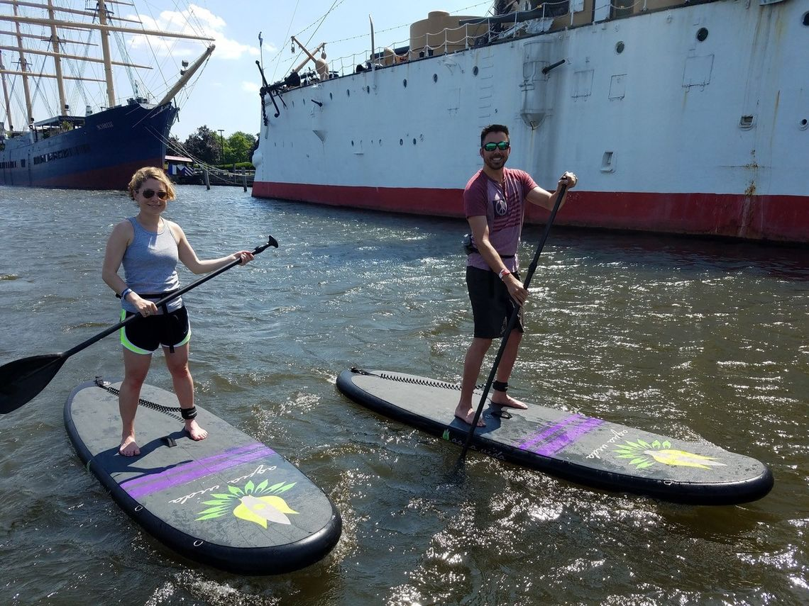
Uses Happening Now
Photo credit: Aqua Vida
Photo credit: Paul Michael Bergeron
Photo credit: Aqua Vida

Slide 13
Gradient of Primary Contact Criteria Attainment
Where are
we now?
Primary contact criteria
never met
Primary contact criteria
always met

Slide 14
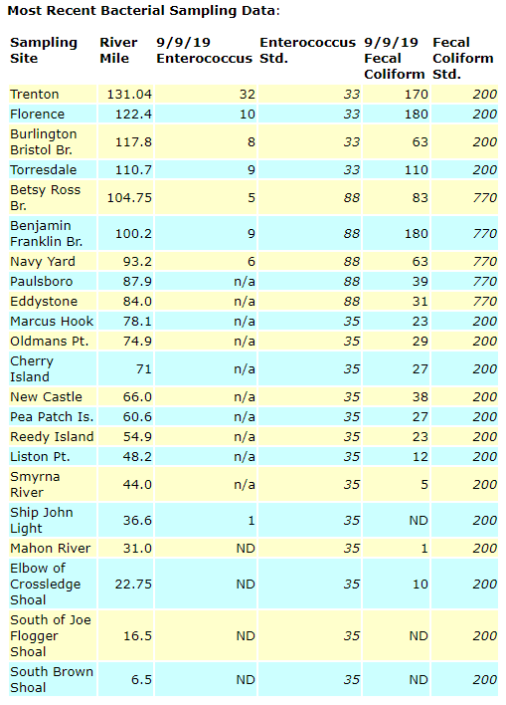
DRBC Monitoring
DRBC’s long-running (50+ year) monitoring program
1x per month
Center channel
Just below Trenton to just above Atlantic Ocean
Bacteria results posted on DRBC web site at https://www.nj.gov/drbc/quality/datum/boat-run.html

Slide 15
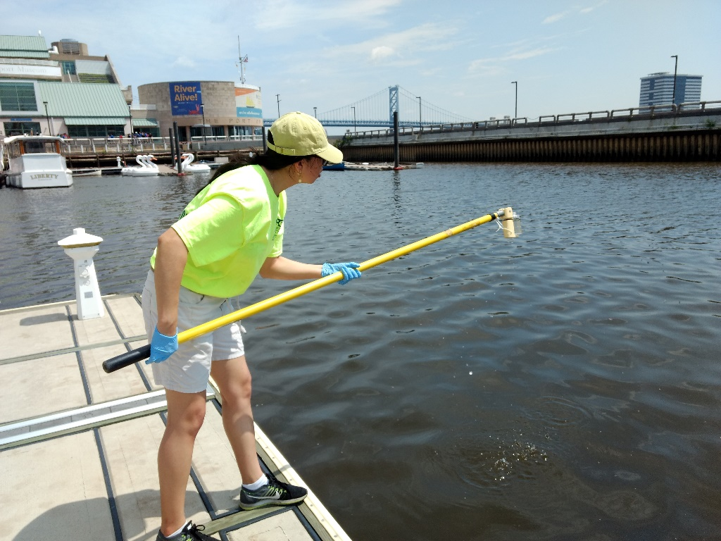
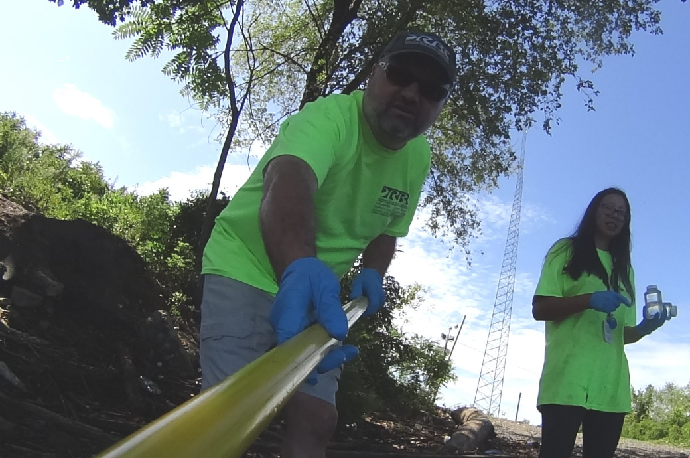
Monitoring Summer 2019
Shore-based, where recreation more likely
~ 5x per month, May - September
Fecal coliform, enterococcus, E. coli
Riverton Yacht Club
Palmyra Cove Nature Center
Pennsauken Access
Pyne Poynt Park
National Park
Washington Ave. Green
Penns Landing Lagoon
Frankford Arsenal Boat Ramp
NJ
PA

Slide 16
http://www.phillyrivercast.org/

Slide 17
DRBC Next Steps
Assess the shore-based data collected in 2019
Boat-based transect monitoring in 2020 to determine if near-shore concentrations are higher than center channel concentrations
Coordination with our Water Quality Advisory Committee (WQAC)
https://www.nj.gov/drbc/about/advisory/WQAC_index.html

Slide 18
Other Hazards / Other Challenges
Busy shipping ports
Hazardous currents
Debris, pilings, junk
Beaches have an elaborate protocol for monitoring, beach closures, re-opening
Liability >> Responsibility & Authority

Slide 19
What can you do?
Citizens
Stay tuned in to DRBC’s Water Quality Advisory Committee & list servs
Volunteer monitoring? Maybe, but…
Develop & follow an approved Quality Assurance Project Plan (QAPP)
State certified laboratory
Short 6-hour holding time from sample dip to drop off at lab
Get your data into WQX
Government organizations cannot take on liability for volunteers
NGOs
Support development of forecasting tool
Support monitoring
Support green infrastructure?

Slide 20
Questions & Discussion
Resources
DRBC’s Water Quality Advisory Committee
https://www.nj.gov/drbc/about/advisory/WQAC_index.html
DRBC e-mail groups
https://www.nj.gov/drbc/contact/interest/index.html
Philadelphia Green City Clean Waters
https://www.phila.gov/water/sustainability/greencitycleanwaters/Pages/default.aspx
Camden County MUA Green Infrastructure
http://www.ccmua.org/index.php/green-initiatives/green-infrastructure/
Contact
John Yagecic
John.Yagecic@drbc.gov
609-883-9500 x271

