Slide 1
Plastics & Pennsylvania
Addressing single-use plastics at the statewide level
Stephanie Wein, Clean Water Advocate, PennEnvironment

Slide 2
Single-Use Plastics in Pennsylvania
Plastic waste in Pennsylvania
The “Ban on the Ban”
The state-level legislative approach & Zero Waste PA
Municipal rebellion

Slide 3
Pennsylvania as an upstream source

Slide 4
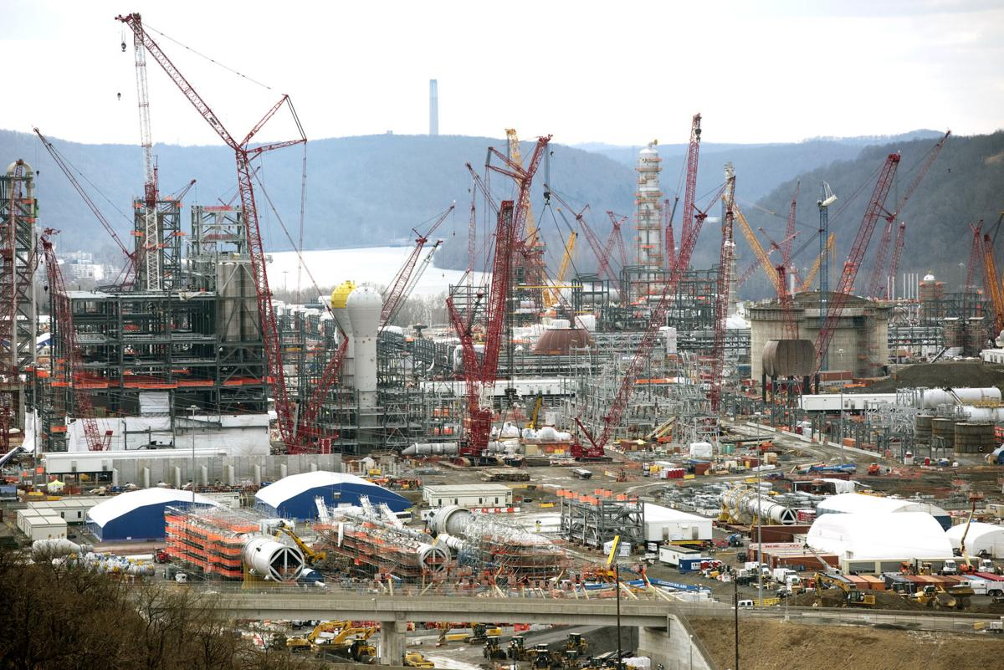
Plastic comes from somewhere

Slide 5
A cradle-to-grave threat
With a dip in oil & gas demand, plastics production will play a larger and larger role in keeping the fossil fuel industries afloat
....which also makes plastics a climate problem

Slide 6
Little local power
Little local power originally
2017: Attempt to pass pre-emption
Democratic sponsor, vetoed by Gov. Wolf
2018: Narberth Ordinance
June 2019: Pre-emption passes in state budget
No local ordinances permitted pending study by DEP
1 year

Slide 7
Ambitious State Strategy
Marker Legislation
2018 - Polystyrene Foam Ban introduced
Starting with one of the worst form of plastic pollution
Ban on restaurants using foam cups or take-out containers
2019 - Zero Waste PA
13 stand-alone bills

Slide 8
2 cent plastic bag fee
Required bottle-filling stations in new & renovated state buildings
Increasing the disposal fee for municipal waste landfills
Modernizing our e-waste recycling
Straw-upon-request only
Foam Cups & Take-Out Container Ban
Increasing the recycling fee paid by landfill operators
Authorizing counties that have recycling programs to collect a recycling and waste management fee
5 cent plastic bottle return bill
Incentivizing development of composting programs
Fines and penalties for illegal dumping
Ensuring that producers of plastic packaging take responsibility for the decisions they make by requiring that they cannot sell or distribute plastic packaging in Pennsylvania unless they are part of a recycling program to take it back
Statewide cigarette filter upcycling initiative

Slide 9
Shifting the conversation
Media coverage
Legislative enthusiasm
Bipartisan interest
Municipal support

Slide 10
Municipal Rebellion
West Chester ban quickly followed passage of pre-emption
Momentum for a bag ban in Philadelphia
Excitement from towns, boroughs around the state

Slide 11
Thanks!
Stephanie Wein
267-438-3397
Stephanie@PennEnvironment.org

