Slide 1
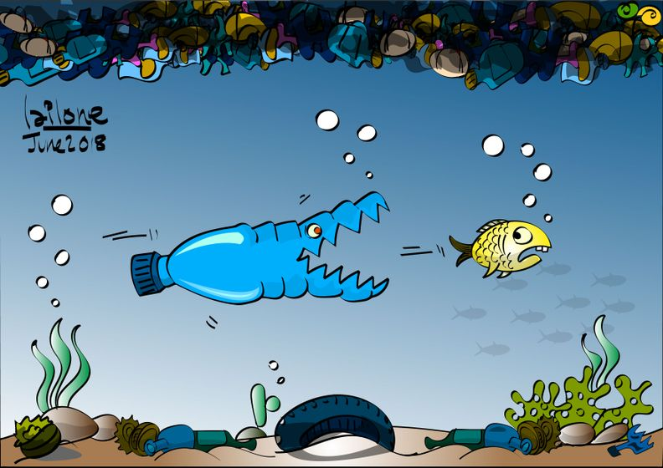
Be the solution to plastic pollution – Maximizing advocacy efforts for local and state success
Presenters:
Stephanie Wein, Clean Water and Conservation Advocate – PennEnvironmet
N. Dini Checko, Project Director – ANJEC
Liz Magill Peer, Chair –
Lambert Environmental Commission
Moderator: Sean Jackson – American Rivers

Slide 2
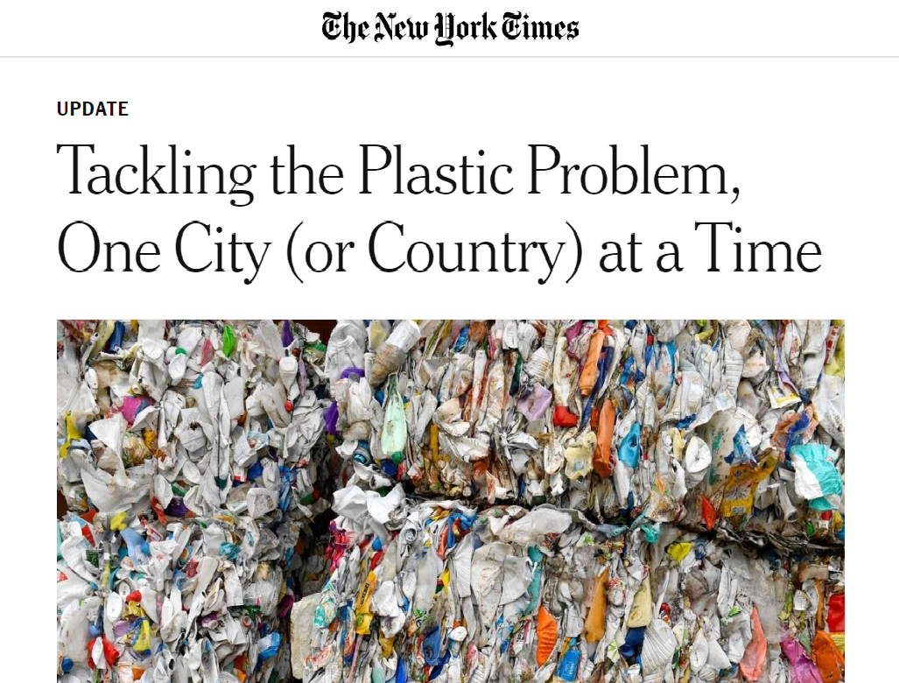

Slide 3
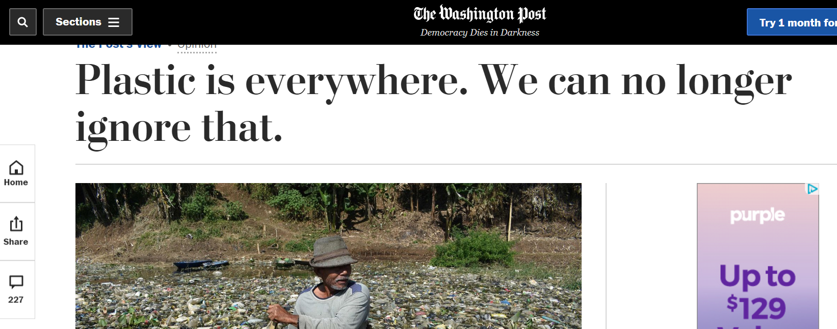
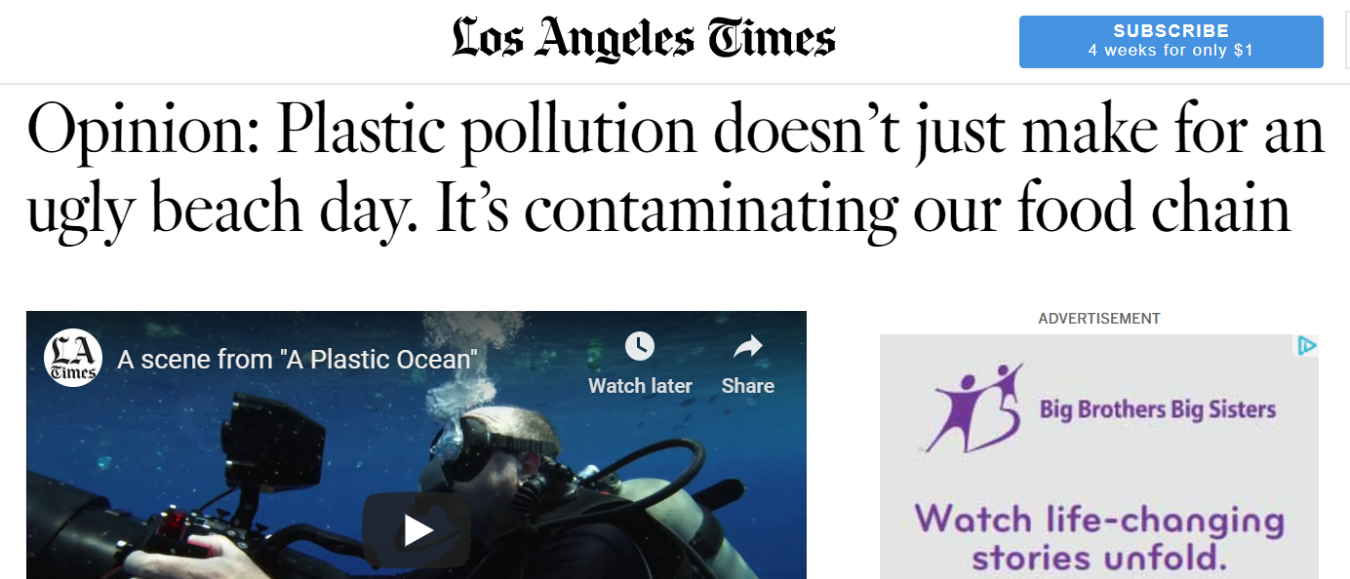
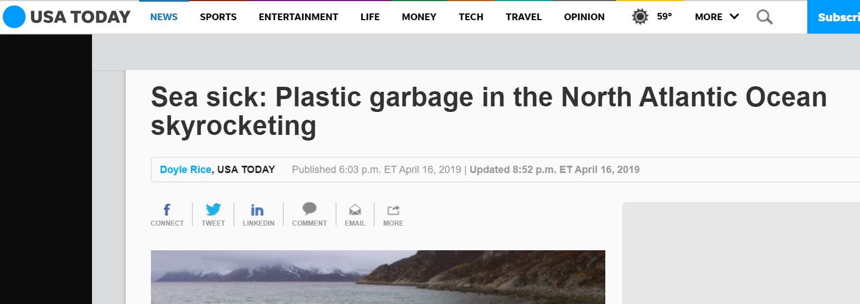
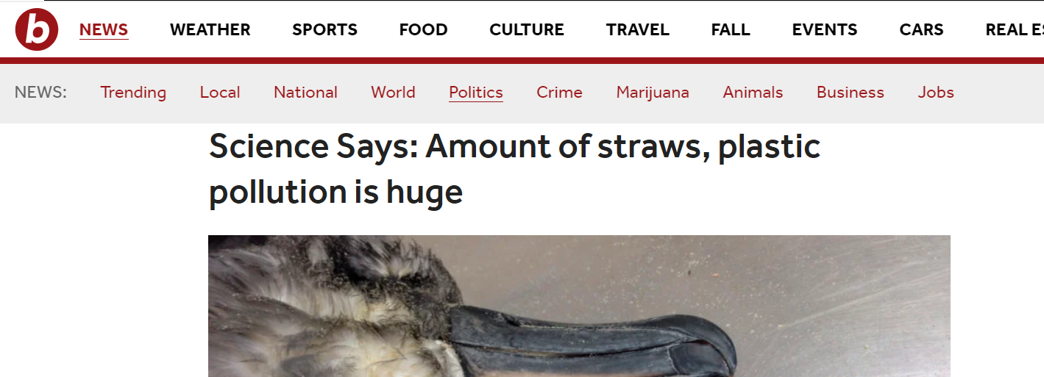

Slide 5
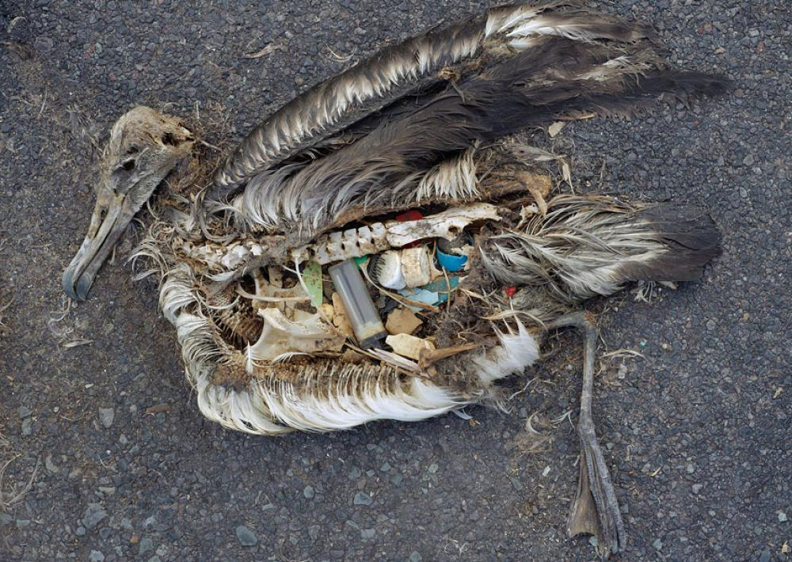
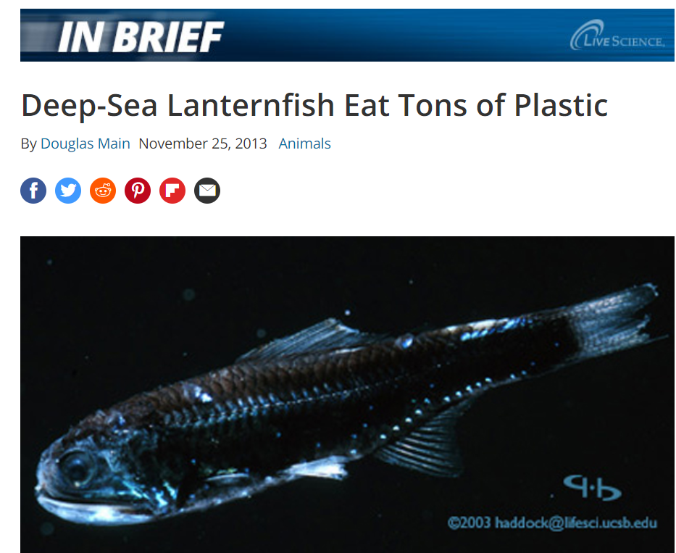
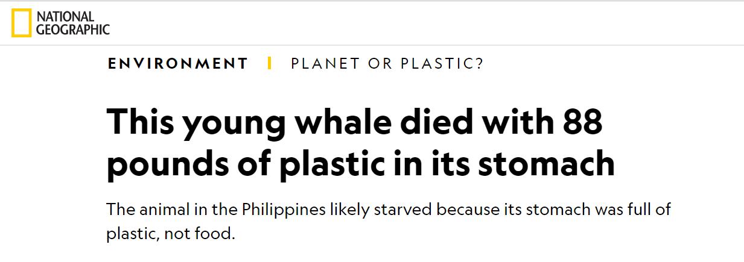
Credit: Smithsonian Institute
Environmental Impacts

Slide 6
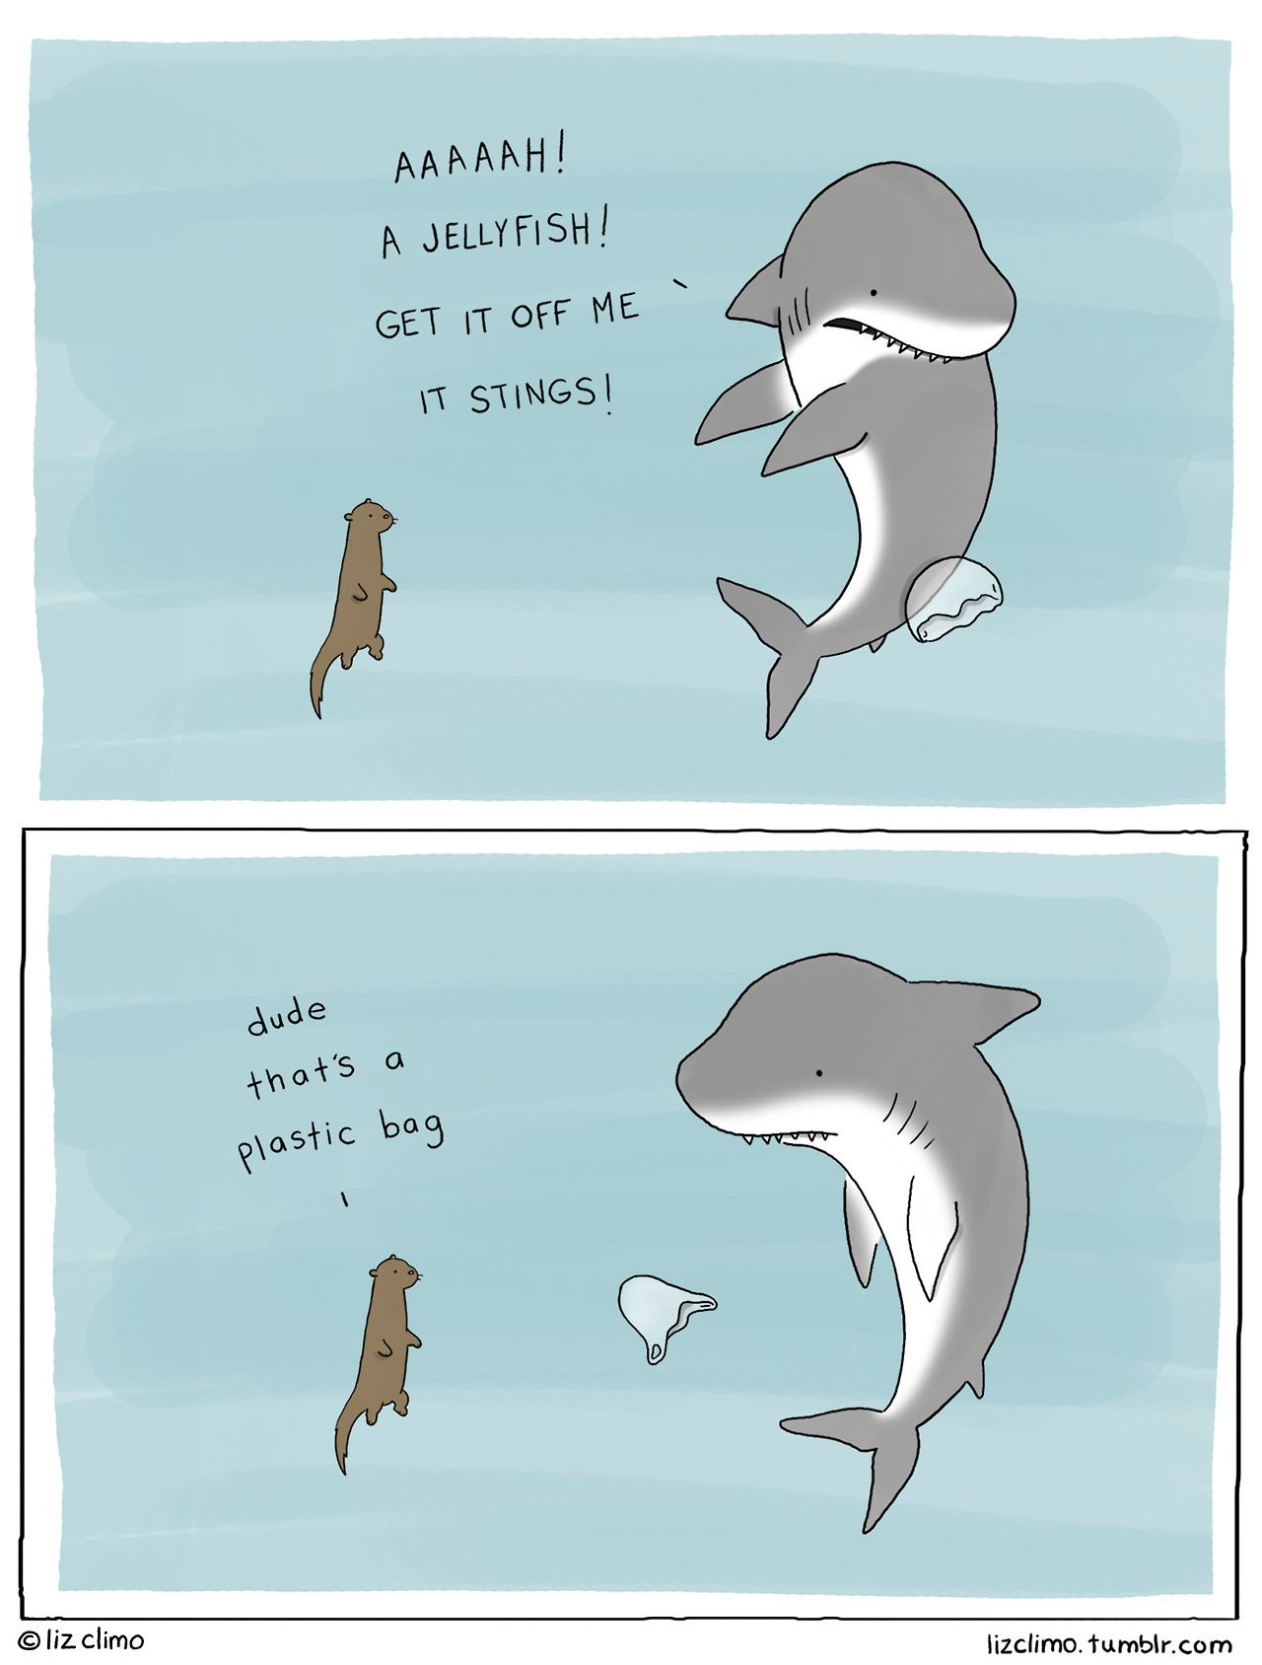
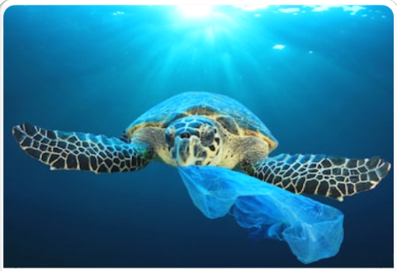
Environmental Impacts

Slide 7
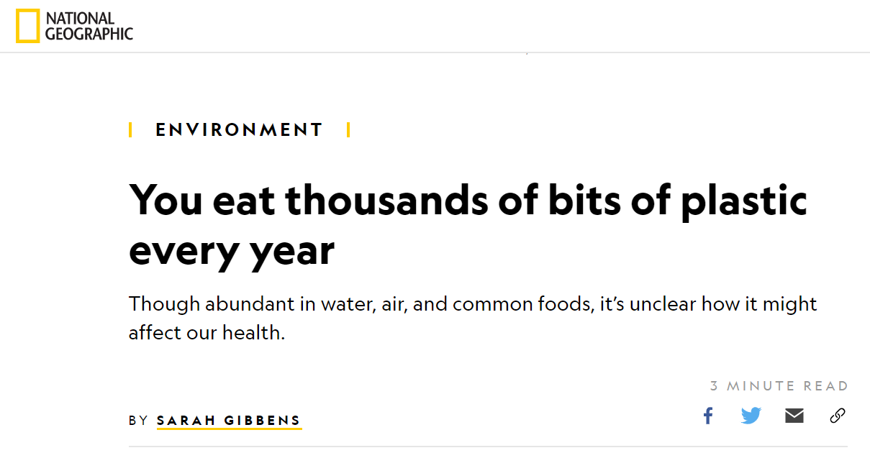
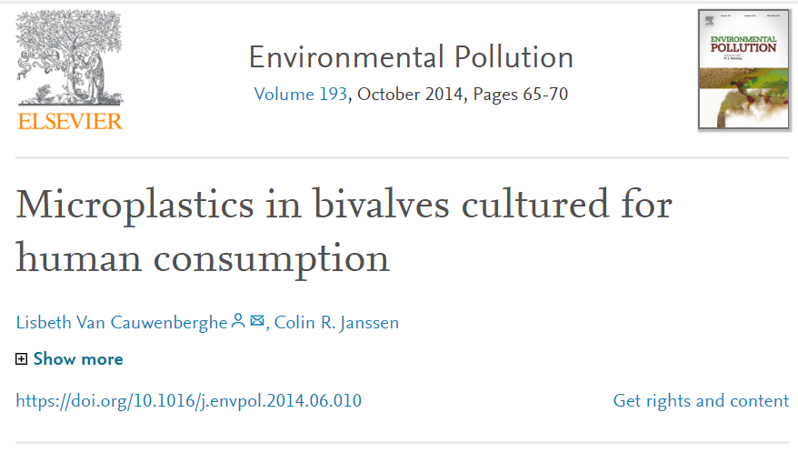
Plastic is Moving up Trophic Levels
is being consumed by us, and is impacting us

Slide 8
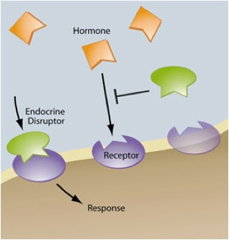
Endocrine Disruptors: The solution is not dilution

Slide 9
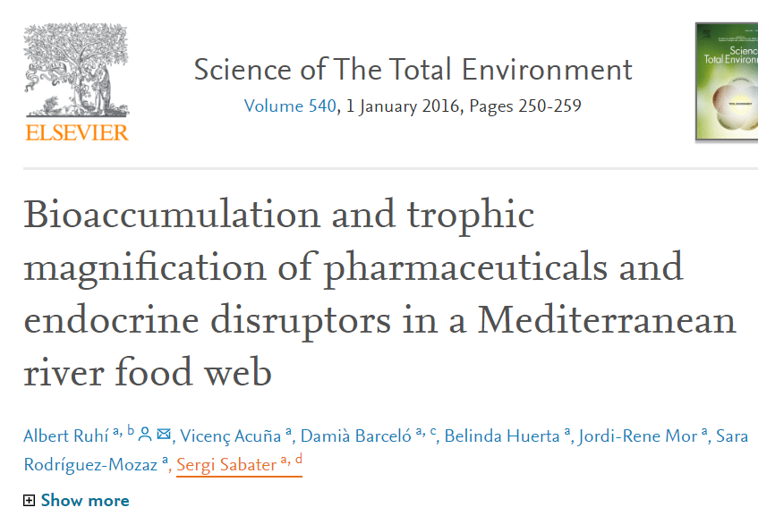

Slide 10
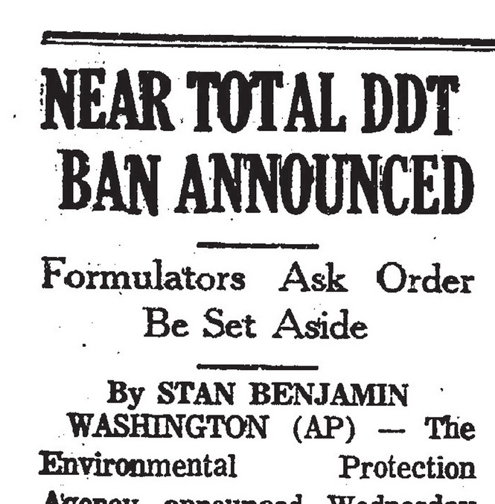
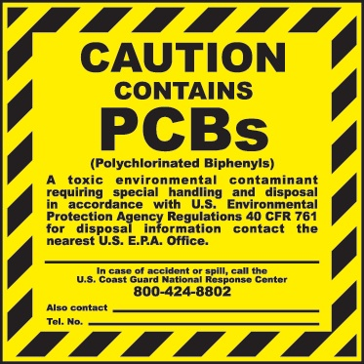
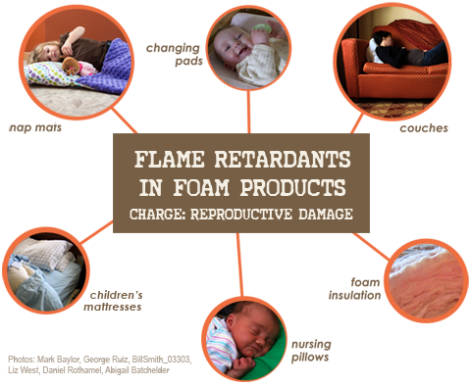
Persistent Organic Pollutants (POPS)
Source: Safe Chemicals, Healthy families

Slide 11
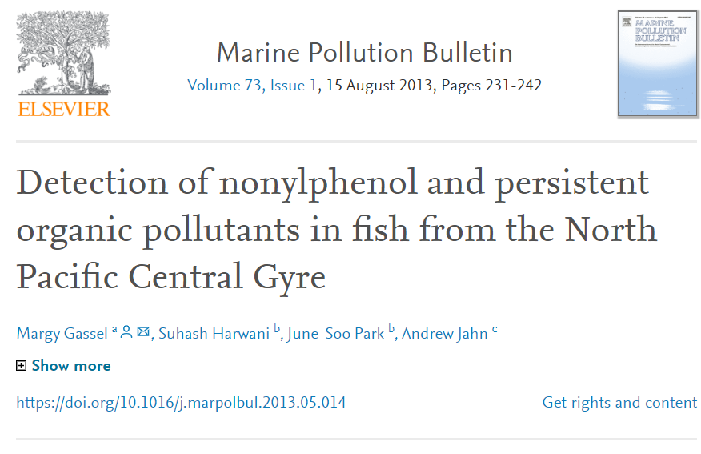
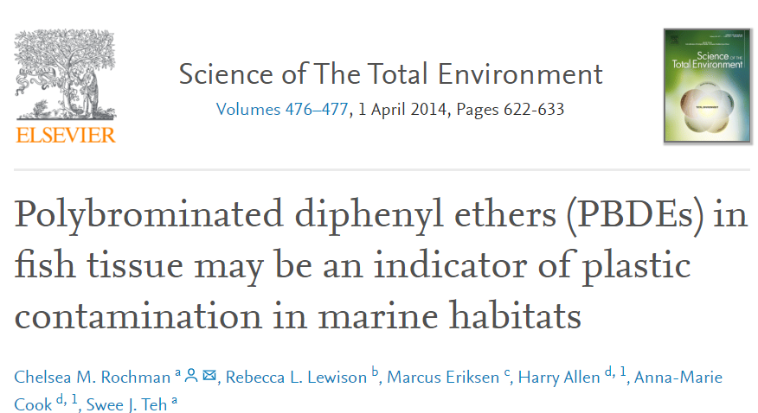
POPs have been found to cause heptic stress in fish, and is in over 10% of tuna

Slide 12
All plastic is microplastic

Slide 13
All plastic is microplastic
Plastic is being ingested by aquatic life and humans

Slide 14
All plastic is microplastic
Plastic is being ingested by aquatic life and humans
The chemical reactions caused by plastic in the marine environment harms life

Slide 15
All plastic is microplastic
Plastic is being ingested by aquatic life and humans
The chemical reactions caused by plastic in the marine environment harms life
There will be more plastic in the ocean than fish by 2050 at current rates

Slide 16
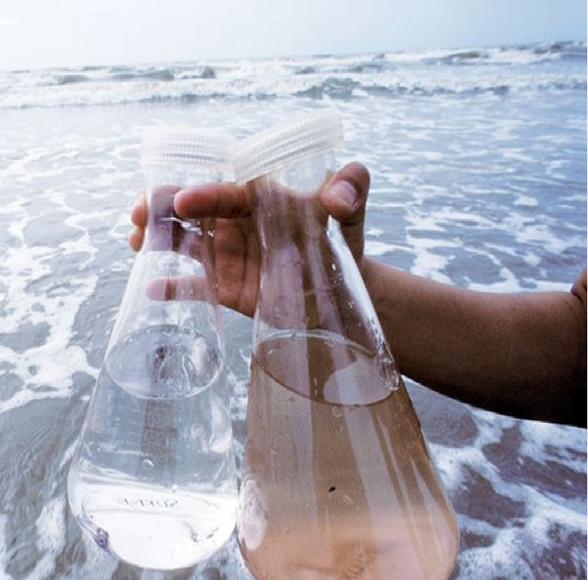
Individuals aren’t enough
EPA does not have published water quality criteria for trash or approved testing methodologies for trash to be evaluated as a pollutant

