Slide 1
Liz Magill Peer
Coalition for the Delaware river watershed 2019

Slide 2
Comprehensive single-use ordinance
September 2018 - ordinance banning single-use plastic bags, straws, & polystyrene foam containers enacted
2019 - Creation & Implementation of ditching disposables initiative with following goals:
1. Educating the community about the harmful effects of single-use plastics on our environment and health.
2. Providing residents and businesses with a range of easy-to-adopt actions that can help them make a successful transition away from single-use plastics.
3. Reinforcing and celebrating positive changes.

Slide 3
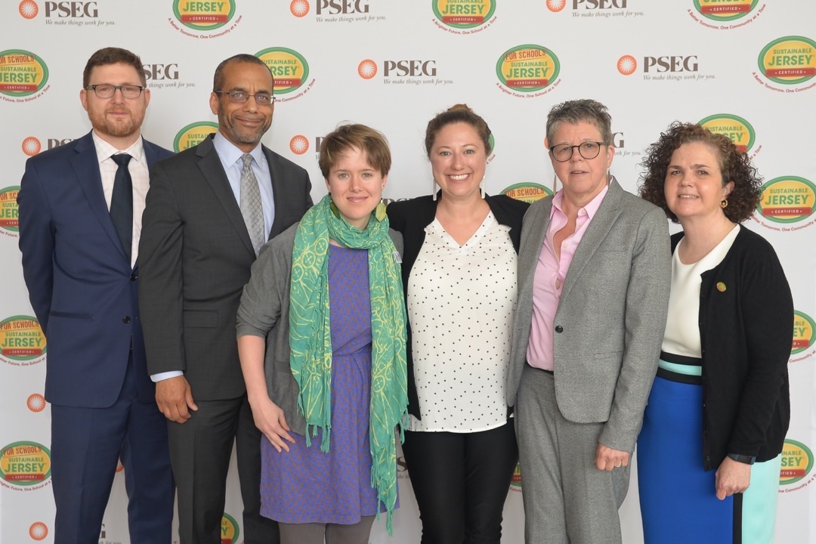
Notes:
Winning $20K grant to implement

Slide 4
Community engagement elements
Sustainability story time
Bag it screening
T-shirts to Totes
Sustainable Business forum
Reusable bag education campaign & community canvassing
Sustainability lecture
Plastics ordinance info session & Distribution of posters to businesses
Green business certification/awards
Notes:
The Ditching Disposables Initiative is comprised of seven projects to support the
education of Lambertville businesses and residents as we transition away from the use of single use plastics. These programs are designed with Community Engagement as the foundation for their success. These programs will engage our businesses and residents through social media, email blasts, award recognition, volunteerism, program signage, printed communications, press coverage, website content and various opportunities for in-person dialogue.

Slide 5
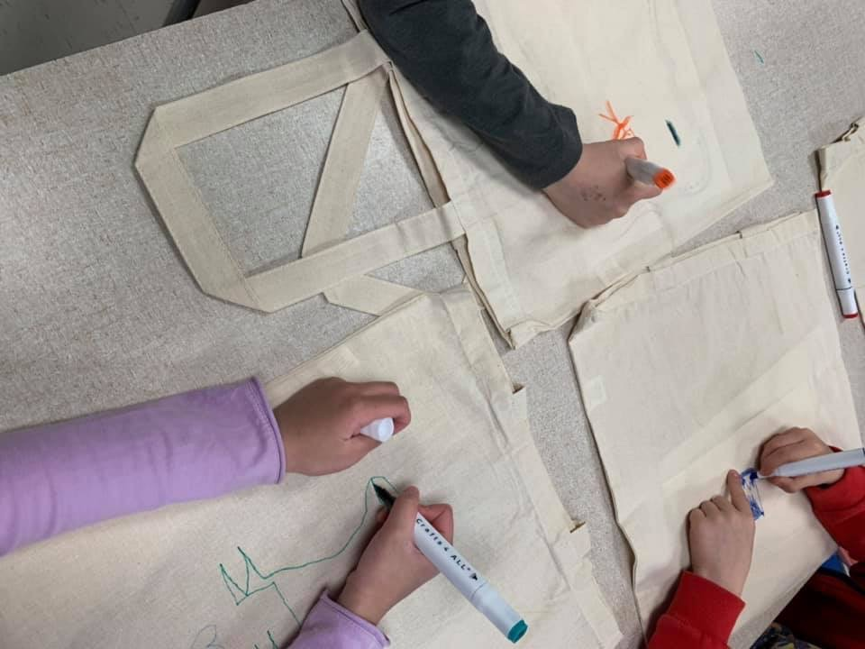
Sustainability Storytime in the classroom

Slide 6
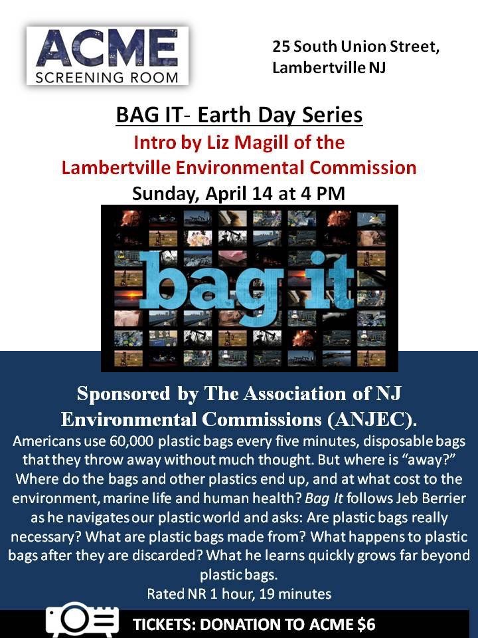
Bag-it screening

Slide 7
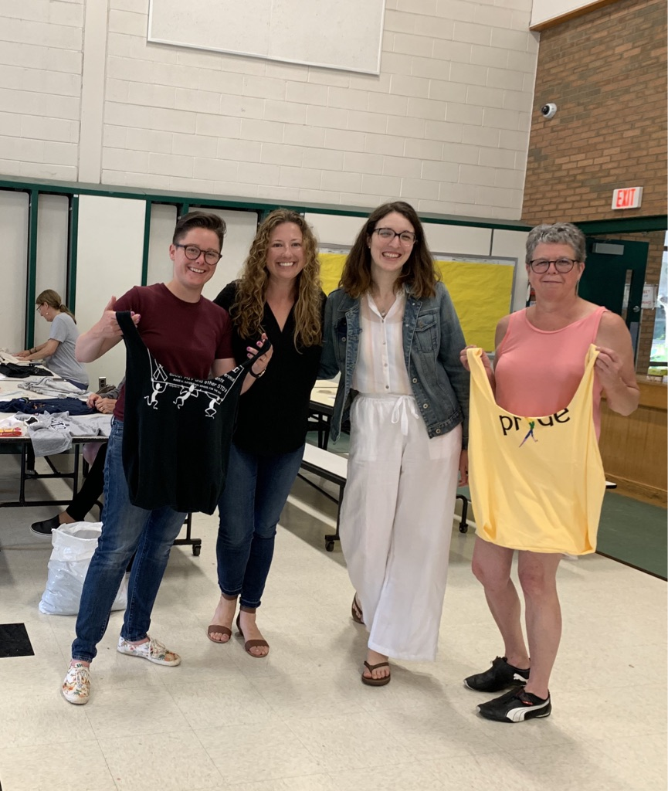
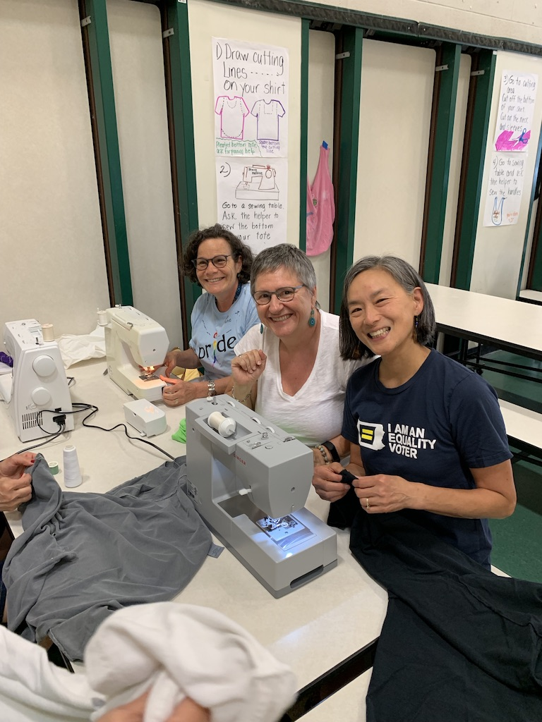
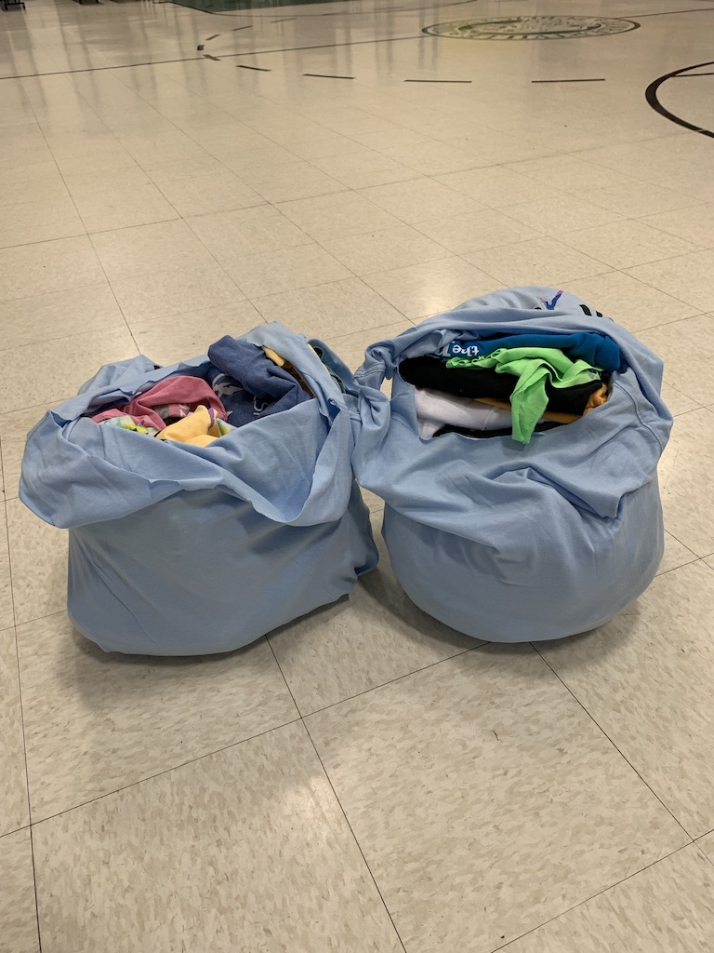
T-Shirts to Totes

Slide 8
Sustainable business forum

Slide 9
Sustainable business award
13 Businesses Nominated
Ongoing…

Slide 10
Learning lessons
Championship from mayor & city officials
Team of dedicated individuals
Brand consistency
Messaging

Slide 11
Upcoming events
October 28, 2019
Community Canvassing training Day
November 3, 2019
Community Canvassing Day
December 16, 2019
Sustainability lecture
Notes:
Wednesday, July 31, 2019 at 1 PM – 2 PM

Slide 12
Thank you!
Follow FB: Lambertville Environmental commission
elizmagill@gmail.com

